Slide 1
ECON*2100 Week 3 – Lecture 2
Sustainability and the Hartwick Rule

Slide 2
Conventional Output Model
Production function: Output is a function of labour times capital (not plus capital)
$$Y=\sqrt{\left(L×K\right)}$$
which can also be written
$$Y=L^{0.5}K^{0.5}$$

Slide 3
Conventional Output Model
Why this form?
Labour without capital = 0 output
Capital without labour = 0 output
For a given level of capital, there are diminishing returns to labour
Y
L

Slide 4
Conventional Output Model
One little change:
Instead of
$$Y=L^{0.5}K^{0.5}$$
Make it
$$Y=L^{0.7}K^{0.3}$$
Because the exponents determine income shares, and labour gets about 70% of national income

Slide 5
What’s missing?
Resources, R
If R goes up, output does as well
Suppose R doubles, and as a result, output goes up 10%. Then we write:
$$Y={R^{0.1}L}^{0.7}K^{0.3}$$

Slide 6
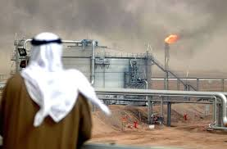
But what if R goes down?
Suppose R is non-renewable
How can an economy keep growing if R keeps declining?
After all, if R = 0, then Y =0 as well

Slide 7
Resource model
The amount of resource stock extracted each period is R
It costs a per unit to extract
It sells for $p_{R}$ per unit
So resource profit per unit (“rent”) is
$q={(p}_{R}−a)$
$p_{R}$ is determined by the marginal product of the resource

Slide 8
Resource model
Hotelling’s principle applies
That means resource managed so that q rises at the same rate as financial interest rates
Capital K is managed the same way
Costs $p_{K}$ per unit, generates a return called “marginal revenue product of capital” $M{RP}_{K}$
Firms buy new capital $(ΔK)$until $M{RP}_{K}=p_{K}$.
This costs $ΔK×p_{K}$

Slide 9
Resource model: re-cap so far
Resource rents each period
$$q×R$$
Capital investment each period
$$p_{K}×ΔK$$

Slide 10
Hartwick Rule
If these two are set equal, so
$$p_{K}×ΔK=q×R$$
Or
$$ΔK=\frac{q×R}{p_{K}}$$
Then output must remain constant:
$$ΔY=0$$

Slide 11
Hartwick’s Rule
In other words,
if the rents from resource extraction are invested in forms of capital that yield the market rate of return,
the increase in K over time will compensate for the decrease in R, just enough to keep output constant

Slide 12
Iso-quant picture
K
R

Slide 13
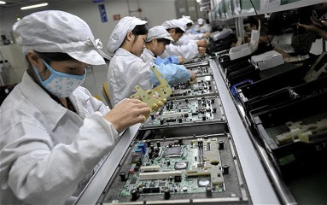
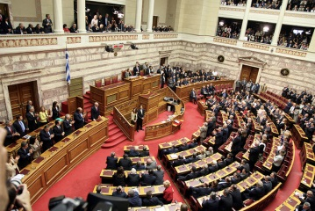
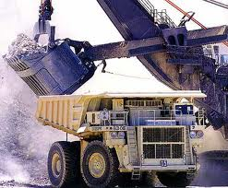
Generalizing the concept
Society has a portfolio of assets:
Natural, industrial, institutional, financial, human
… and non-renewable

Slide 14
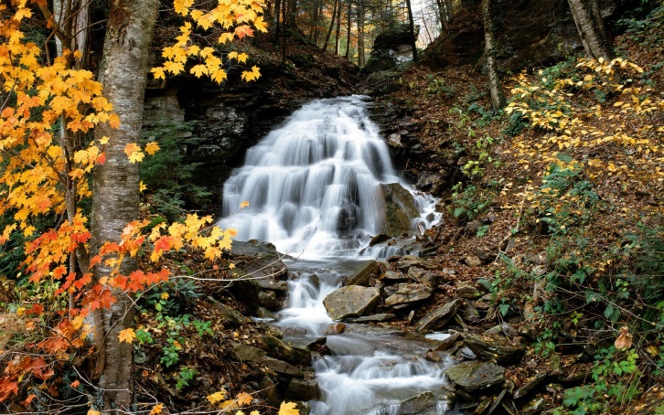
“Value” of an asset
Value is not the same as the cost of purchasing it
It means the capacity to generate human welfare in the future

Slide 15
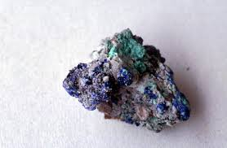
Non-renewable assets
Ore in the ground is worthless if it is never extracted
Once extracted it is worth a certain amount, say $X
If we just spend $X on current consumption we have depleted our wealth
If we invest it in something with rising value, we can preserve our overall wealth

Slide 16
Investment options
Preserving non-renewables not necessarily the best option for future generations
If other assets grow in value more quickly we should invest in those
What would future generations want us to invest in?

Slide 17
What would future generations want from us?
Same as what we wanted from generations earlier to us:
A portfolio of valuable assets, not just one type

Slide 18
Summary
Society has a portfolio of valuable assets, including non-renewable ones
Hartwick rule says that if the rents from non-renewable resource extraction are invested in other forms of productive capital, future output need not go down

Slide 19
Next:
Externalities

