Slide 1
Global Warming and Climate Policy: Is the Cure Worse than the Disease?
Ross McKitrick
Professor of Economics
University of Guelph
Presentation to the Guelph-Wellington Men’s Club
February 28, 2017

Slide 2
No shortage of things to worry about
The list of things needing attention is endless
Public policy always requires making choices and setting priorities

Slide 3
Two simple rules
Among strategies that accomplish the goal, pick the one that costs the least
Make sure the goal is set so the benefits of achieving it are greater than the costs

Slide 4
An example where both went wrong
Ontario electricity policy
Goal: reduce particulate pollution and ozone formation
Strategies: (1) retrofit coal plants,(2) replace coal with gas/nuclear combination, (3) replace coal with renewables
Problems
Coal was never much of a contributor to PM and Ozone
Province chose option (#3) at a cost more than 10x (#1)

Slide 5
Climate policy
What is the goal?
What are the options?

Slide 6
What is the Goal?
Often ill-defined
“Stopping” or “Tackling” or “Combatting” climate change?
But this is as impossible as “stopping” continental drift

Slide 7
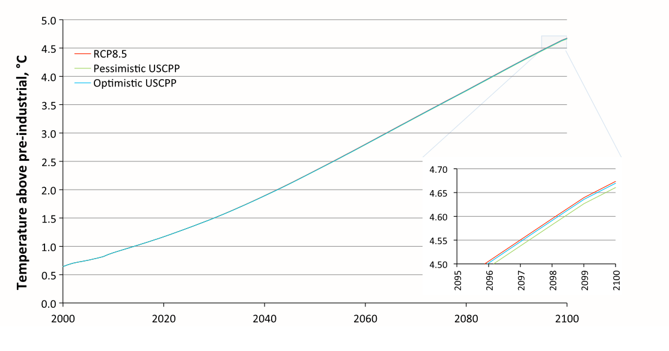
What is the Goal?
US Clean Power Plan: effects on climate 0.004-0.008C after 100 years

Slide 8
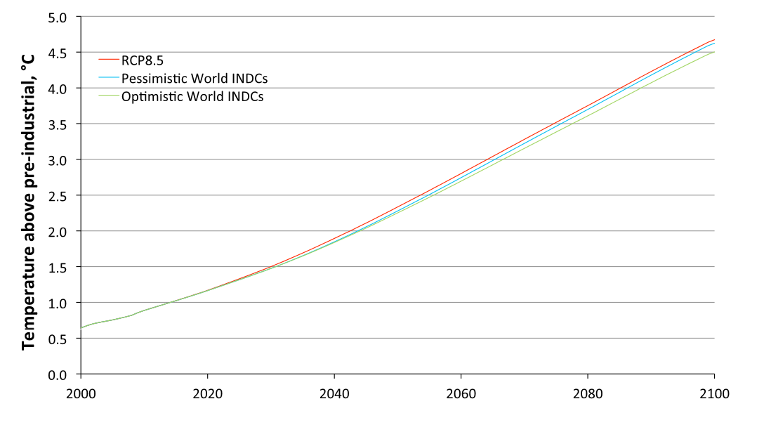
What is the Goal?
Paris treaty: effects on climate 0.05-0.17C after 100 years

Slide 9
What is the goal?
No one would try to sell either policy based on what they actually accomplish.
Ontario’s coal phaseout would do even less
Economists think of these things in terms of prices rather than quantities
GOAL: Make polluters pay the social cost of their emissions

Slide 10
Social Cost Approach
Charge polluters the social cost of their emissions
Instead of not In addition to ordinary regulations
This deals with both policy requirements:
Set the cost so that it reflects actual damages
In response, emitters will find the lowest-cost compliance strategies

Slide 11
Social Cost of Carbon
The current value of the global social costs of a tonne of CO2 emitted today
Computed using IAMs – Integrated Assessment Models
Best-known numbers come from the Inter-Agency Working Group of the US government (IWG)
Big problem: Uncertainty over “Climate Sensitivity”

Slide 12
Equilibrium Climate Sensitivity
ECS
How much the world will warm after doubling CO2 and allowing the climate system to adjust
Computed using model simulations
Traditional estimate: 1.5 – 4.5C, maybe as high as 10C

Slide 13
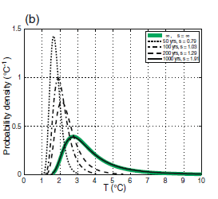
IWG Estimate
Used a distribution of ECS values
Each one implies a different Social Cost of Carbon

Slide 14
IWG Estimate
Ran models 10,000 times drawing new ECS value each time from distribution
Computed SCC using 3 different IAMs, took average
Result: as of 2020, SCC is about $38 US per tonne

Slide 15
Problem: Empirical ECS literature

Slide 16
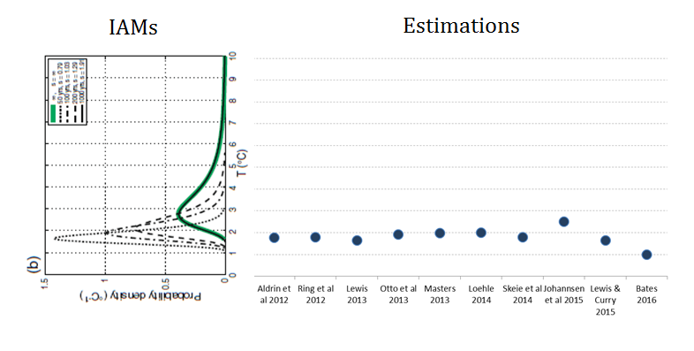
Problem: Empirical ECS literature

Slide 17
Problem: Empirical ECS literature

Slide 18
Problem: Empirical ECS literature
DICE

Slide 19
Problem: Empirical ECS literature
DICE

Slide 20
Lewis & Curry 2015
Estimated using IPCC forcings post-1750 and most recent surface and ocean data
Conditioned ECS on estimated OHU efficiency
Results stable across numerous different start- and end-dates
ECS best estimate 1.64 C
[5—95%] range of 1.05 – 4.05 C

Slide 21
FUND & DICE
Used IWG’s Matlab code obtained from EPA
PAGE code unavailable
Replicated IWG (2013) results using their ECS distribution then replaced it with Lewis-Curry distribution.

Slide 22
Result based on DICE and FUND
Avg SCC Estimate out to 2050

Slide 23
FUND
Probability of negative SCC

Slide 24
Estimated SCC
Based on mainstream science and economics, the SCC is pretty low, likely below $15 / tonne and may not even be above zero
Costs of Canada’s climate policies:
Vehicle efficiency standards: over $300 per tonne
Home energy efficiency standards: over $400 per tonne
Coal phaseout: over $500 per tonne
Alberta oil sands cap: over $1,000 per tonne
Biofuels mandate: over $3,000 per tonne

Slide 25
Concluding comments
Mainstream estimates of the “cost” of CO2 emissions are low, especially using up to date datasets and methodologies
Canada has implemented policies that cost far more than realistic estimates of their benefits
On climate policy, at this point the “cure” is worse than the “disease”

