Slide 1
Presention to Session on Social Equity, Environment and Distribution
Prof. Ross McKitrick
Dept of Economics
University of Guelph

Slide 2
2-sided equity considerations
Distribution of benefits of environmental quality
Distribution of costs of environmental policy
Conjecture: Another Environmental Kuznets Curve

Slide 3
Another EKC
Early stages: environmental policy benefits all classes, especially lower-income groups
  Equity increases
Later stages: environmental policy primarily benefits well-off; costs disproportionately fall on lower-income groups
  Equity decreases
Equity
Stringency of policy

Slide 4
2 Examples
Ontario air quality and the Green Energy Act
Medupi Power Plant South Africa
Both illustrate:
  Modern environmentalism is increasingly an indulgence of wealthy communities who are shielded from the costs of the policies

Slide 5
Ontario Air Quality
Illustrated with Toronto data:
  Data from NAPS stations at
    Bay & Wellesley (BW)
    Queensway & Hurontario (QH)
    Lawrence and Kennedy (LK)
  Monthly averages + 12-month MA
  Pre-1974 data from Ontario MOE
  NAAQS Lowest Desirable Standard

Slide 6
Toronto Air Pollution Trends

Slide 7
Toronto Air Pollution Trends

Slide 8
Toronto Air Pollution Trends

Slide 9
Toronto Air Pollution Trends

Slide 10
Green Energy Act 2009
Context: 4 decades of improvements in air quality
No general compliance problems
Reasonable balance of benefits and costs
GEA Effects:
  At best only trivial changes to already-low pollution levels
  Large regressive increases in energy costs
  Urban areas shielded from disamenities of Wind Turbine installations

Slide 11
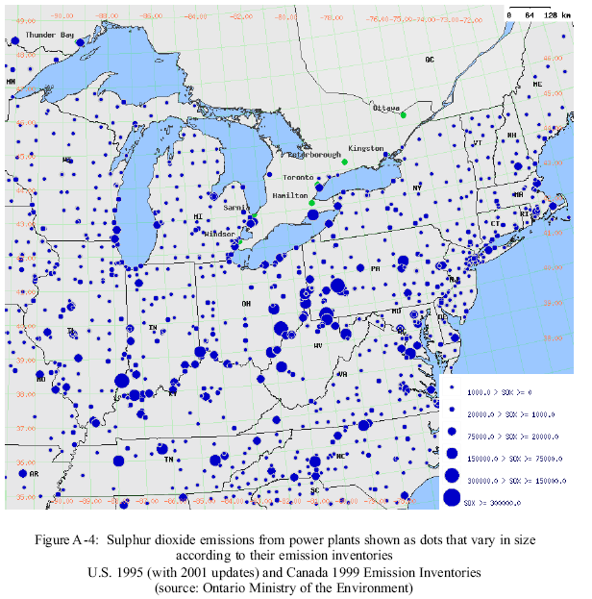
Impacts of Lambton & Nanticoke on Ontario Air

Slide 12
Impacts of Lambton & Nanticoke on Ontario Air

Slide 13
Impacts of Lambton & Nanticoke on Ontario Air
DSS/RWDI Reports (2003, 2005)
Total contributions to O3, PM10:
  < 1% of ozone
  < 5% of PM10
  Emission controls achieve ~75% of what closure would yield

Slide 14
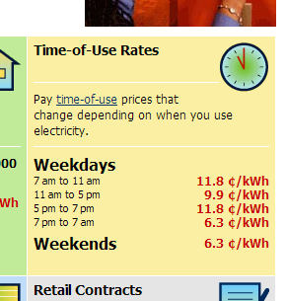
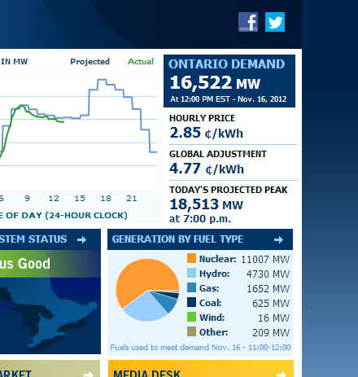
Distribution of Costs of Closure

Slide 15
Distribution of Costs of Closure

Slide 16
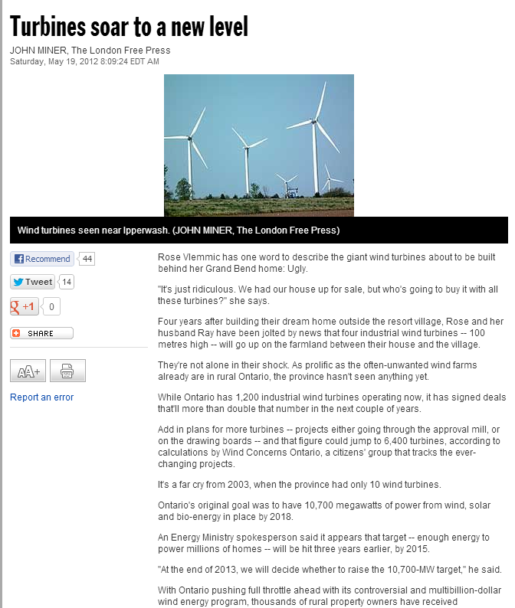
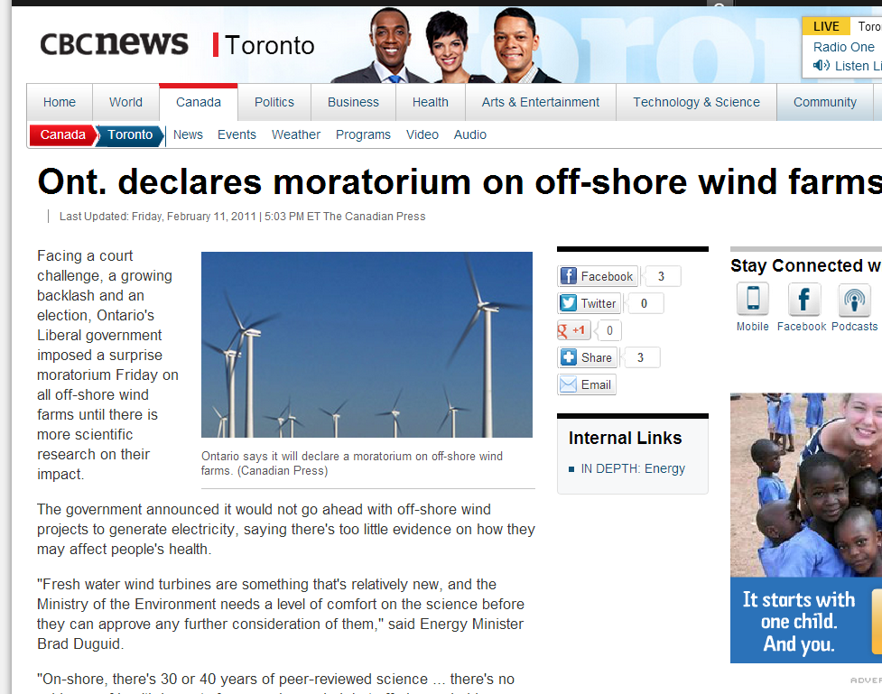
Urban vs rural impacts

Slide 17
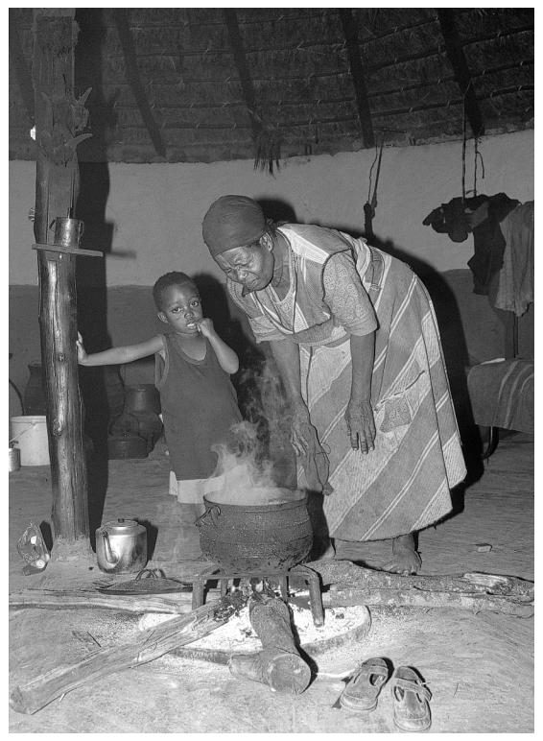
Example 2: South Africa
Major air quality issue in many 3rd-world communities arises due lack of electricity
Indoor coal, peat, dung and wood fires
Lung disease, cancer, COPD, cataracts, low birth weight etc.
Regional haze and deforestation
Solution: electrification

Slide 18
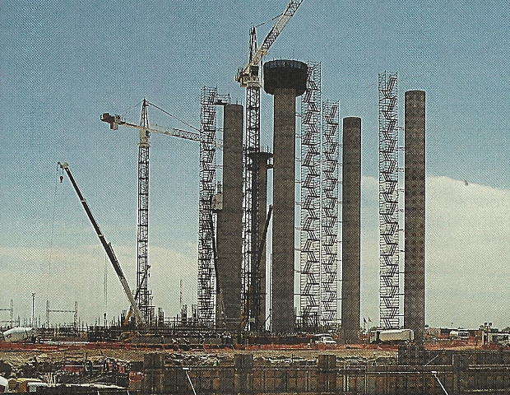
Medupi Power Plant
“South Africa desperately needs more electricity capacity. Its existing system is already under pressure and in 2008 came close to collapsing. Rolling blackouts had to be imposed, causing massive damage to the productive economy. As a major coal producer, it made sense to go for coal and it Eskom, the power utility, is planning a 4,800-megawatt coal-fired plant at Medupi in the northern Limpopo region.
Without energy, countries face very limited or no economic growth: factories and businesses cannot function efficiently; hospitals and schools cannot operate fully or safely; basic services that people in rich countries take for granted cannot be offered.”

Slide 19
Medupi Power Plant
South Africa applied to the World Bank for a loan to help complete construction of the Medupi power plant. The loan was narrowly approved on April 9, 2010, but was opposed on environmental grounds by
  125 western environmental and foreign aid groups
  The governments of the US, UK, Denmark and the Netherlands.

Slide 20
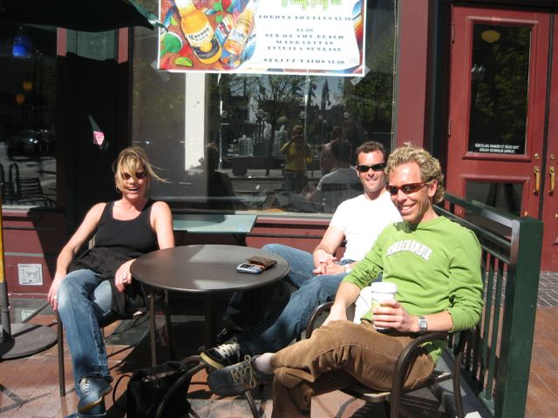
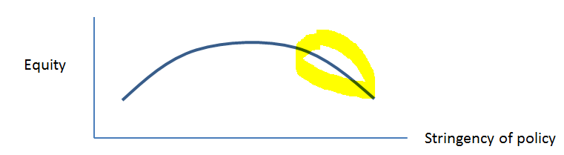
Conclusion
Calls for ever-tighter environmental policy tend to come from wealthy urban westerners who:
  Are personally shielded from many of the costs of implementation
  Derive an emotional “warm glow” from the policy
  Express the benefits in terms of slogans and generalities but can provide no quantitative estimates
As a result we are on the downward-sloping portion of the Policy-Inequality curve

