Slide 1
ECON*2100 Week 2 – Lecture 2
The Solow Growth Model

Slide 2
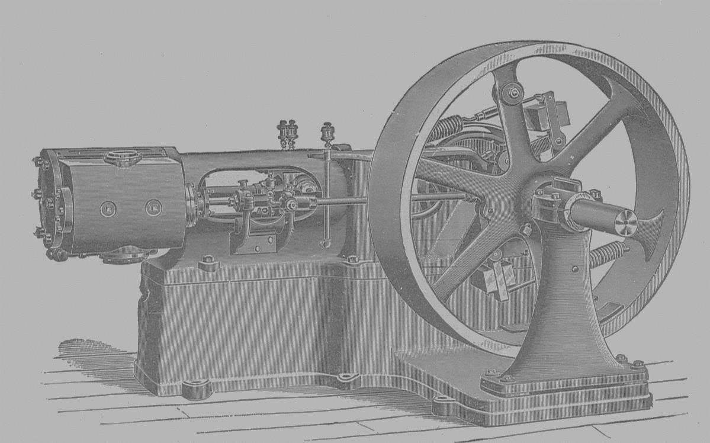
After Smith
Industrial revolution in 1800s, invention of steam engine
Various writers recognized that investment and capital formation mattered
1930s: Keynes argued that increasing Aggregate Demand and consumption were necessary to achieve growth
1950s: Solow argued that savings, not consumption, drives growth

Slide 3
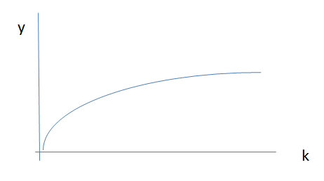
Basic set-up
Production function
Y = f(L, K)
Re-express in per-worker terms
Y/L = f(K/L)
y = f(k)

Slide 4
Savings
Each period, output is either for consumption or investment
y = c + i
Also, income is either consumed or saved
Savings fraction = s
C = (1-s)Y
c = (1-s)y

Slide 5
Savings = Investment
c = (1-s)y
y = (1-s)y + i
y = y – sy + i
y – y + sy = i
→ i = sy = s∙f(k)

Slide 6
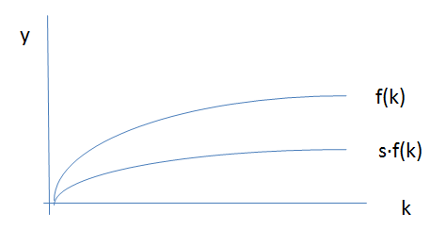
Savings = Investment
i = s∙f(k)
Now add depreciation: d∙k
d∙k

Slide 7
Steady State
Change in capital each period
∆k = i - d∙k
Steady state: ∆k = 0
So in steady state, i = d∙k

Slide 8
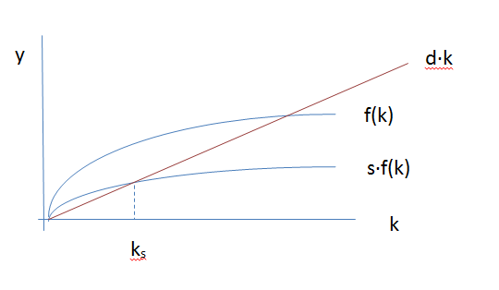
Steady State
Graphically:

Slide 9
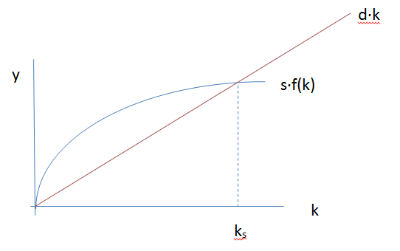
Steady State
Enlarge lower part:

Slide 10
Steady State
Graphically:
consumption

Slide 11
Optimal growth
Go to the level of capital per worker that maximizes consumption
Too little investment means low productivity
Too much means excess savings
y = c + i
c = y – i
c = f(k) – s∙f(k)

Slide 12
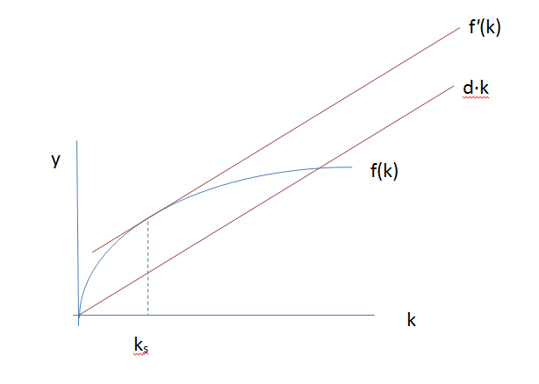
Optimal growth
c = f(k) – s∙f(k)
c = f(k) – d∙k
Maximize this where
f'(k) – d

Slide 13
Implications
Economies grow through savings
Amount of capital per worker is key to growth
Low-income countries should grow rapidly compared to high-income countries
Growth ends at a steady state level of capital per worker and per-capita income

Slide 14
Next
Population Growth

