Slide 1
ECON*2100 Week 3 – Lecture 1
Resources Management and the Economy

Slide 2
Resource Scarcity: A trick question
“
We have timber for less than thirty years at the present rate of cutting... We have anthracite coal for but fifty years, and bituminous coal for less than 200. Our supplies of iron ore, mineral oil and natural gas are being rapidly depleted, and many of the great fields are already exhausted.
In what year was this warning issued:
1973 ?
1961 ?
1935 ?

Slide 3
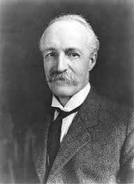
Resource Scarcity: A trick question
Gifford Pinchot, US Chief Forester
The Fight for Conservation
1910

Slide 4
Another trick question
Everything has been visited, everything known, everything exploited. Now pleasant estates obliterate the famous wilderness areas of the past. Plowed fields have replaced forests, domesticated animals have dispersed wildlife…There are as many cities as, in former years, there were dwellings…Everywhere there are buildings, everywhere people, everywhere communities, everywhere life…We weigh upon the world; its resources hardly suffice to support us. As our needs grow larger, so do our protests, that already nature does not sustain us.
1906?
1871?
1418?

Slide 5
Tertullian
200 AD
Treatise on the Soul ch. 30

Slide 6
We’re running out of food
“
Spaceship Earth is now filled to capacity or beyond and is in danger of running out of food. And yet the people traveling first class are, without thinking, demolishing the ship’s already overstrained life-supporting systems.
Paul and Anne Ehrlich, 1972

Slide 7
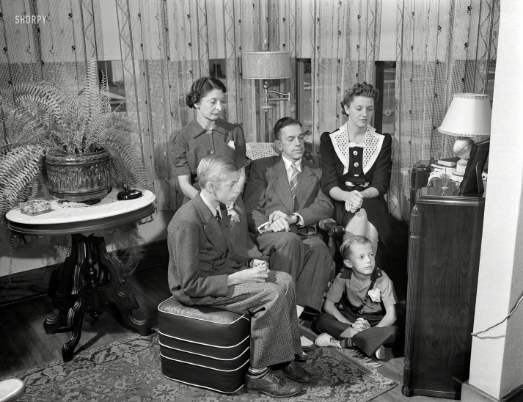
We’re at the limits of the Earth
Now as we look, we can see the limits of the earth…If we are blind to this law, or delude ourselves into minimizing its power, of one thing we can be assured—the human race will enter into days of increasing trouble, conflict and darkness.
Henry Fairfield Osborne, 1953
“

Slide 8
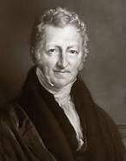
Modern Malthusianism
Every 10 years or so we hear grave warnings that we are facing ruin due to exhausted supplies of resources and/or ecological ruin
Why don’t we run out of resources?

Slide 9
Principles of Resource Management
Non-renewable resources
Hotelling rule
Renewable resources
Forests: Faustmann rule

Slide 10
Ideas in common
A resource is like an asset with a potential dollar value
The crucial decision is when to convert it from a physical asset to a financial asset
BANK

Slide 11
When to extract resource?
BANK
Q tonnes of ore, could be sold for $P / tonne
Once extracted it is worth $PxQ at today’s prices
You can invest $PxQ and earn, say, 5% in the bank
If the market price of ore goes up by 10%, you’d have been better to leave it in the ground

Slide 12
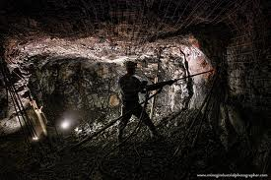
Hotelling rule (mining)
If you expect the resource value to go up faster than the rate of return on financial investments, slow down extraction
If you expect the resource value to go up slower than the value of financial investments, speed up extraction

Slide 13
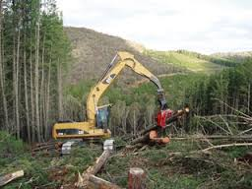
Faustmann Rule (forestry)
A forest adds q% to its wood volume each year
At first, q is very high, but as stand matures, q drops to zero
When q drops to the market interest rate, it is time to cut the stand

Slide 14
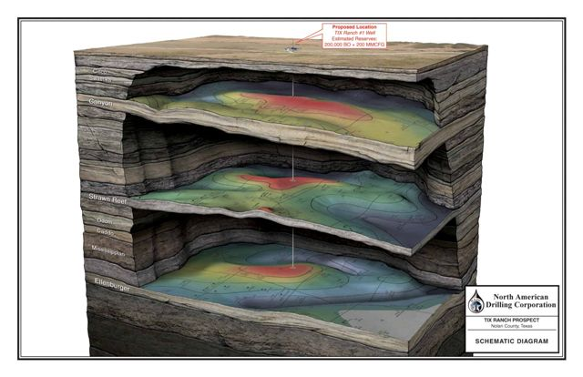
“Proving Up” Reserves
At any one time there are about 30 years worth of proven oil reserves
In addition, there are estimated and potential reserves in many regions

Slide 15
“Proving Up” Reserves
It is costly to go into new regions and do the drilling required to “prove up” reserves
Companies only invest in this activity up to the point where the likely payoff is worth the cost

Slide 16
World Proved Oil Reserves
Measured in years of current consumption

Slide 17
Suppose we are running short
If the resource is in demand and supply shrinks, the price will start rising
Resource managers will slow down extraction and keep more in the ground
The upward swing in prices causes demand to decline
People curtail their use as much as possible

Slide 18
Suppose we are running short
Price
Quantity
We expect to observe the price get higher and higher
And as a result, quantity demanded gets lower and lower
We never “run out”, it just gets too expensive for most users

Slide 19
Institutions Matter
Property rights
Controlled access
Stable planning climate

Slide 20
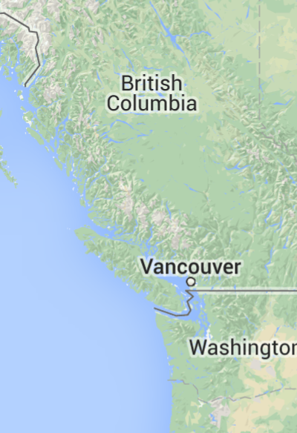
Property rights
BC
Forests publicly owned
Large cutblocks, poorly-drained roads, weak reforestation
Washington
Forests privately owned
Smaller cutblocks, good roads, intensive reforestation

Slide 21
Property rights
Public forests in BC
For many years, timber harvesting licenses were 5 years or shorter
Companies doing the cutting had no financial stake in the next generation’s forest
Private forests in Washington
Large companies like Weyerhauser have a permanent interest in maintaining the productivity of their forest
They benefit from doing a good job of cutting and replanting

Slide 22
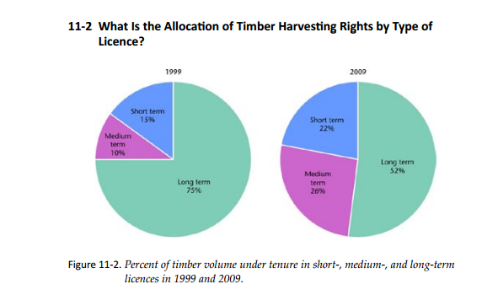
Property rights
BC, 1990s
Began move towards 30-year Tree Farm Licenses with automatic renewals
The aim is to give forest companies stable, long term interest in a forest section so they expect to benefit if they do careful cutting and replanting
But it is politically difficult, and long term leases have actually declined

Slide 23
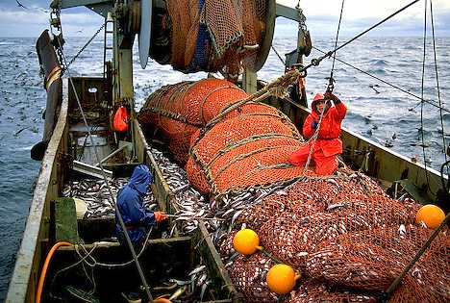
“The Tragedy of the Commons”
What if no one owns a resource but everyone can access it?
This usually leads to over-exploitation
Example:
Ocean fisheries

Slide 24
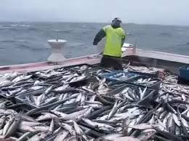
“The Tragedy of the Commons”
Everyone knows that they are over-exploiting the resource, but no one has an incentive to stop
Each captain thinks:
If everyone else keeps harvesting and I stop, I lose out and the fishery will be ruined anyway, so I am better off harvesting
If everyone else stops harvesting, my catch won’t matter, so I am better off harvesting

Slide 25
“The Tragedy of the Commons”
Either way I am better off taking the catch, even if I know the fishery will be ruined
Solution: mechanisms to control access

Slide 26
Access Control
Enclosures Movement – England
1760-1832
Open fields bought up and fenced
Peasant farmers displaced to cities
Landowners began investing in modern methods

Slide 27
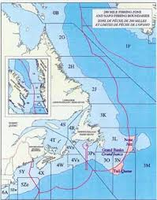
Access Control
Ocean fisheries
200 mile limit imposed
Catch limits set
Tradable catch quotas

Slide 28
Stable planning climate
“Sovereign risk”
The fear that once a resource is developed, the government will seize ownership
Mining requires costly exploration and development
Equipment is also very costly
Why bother if the government will seize or block your mine before you can profit from it?

Slide 29
Summary
Every decade we hear warnings of doom from running out of resources
Resources are managed as capital assets
Rate of extraction is related to expected gain from waiting, relative to expected gain from financial investment
We don’t “run out”, resource just gets too costly
Exploration is costly, so industry only maintains a 30-40 year supply

Slide 30
Summary
Institutions matter:
Property rights
Controlled access
Sovereign Risk

Slide 31
Next
Sustainability and substitution: The “Hartwick Rule”

