Slide 1
ECON*2100
Week 1 – Lecture 3
Economic Growth and the Environment

Slide 2
Try to strike this term from your vocabulary:
The Environment

Slide 3
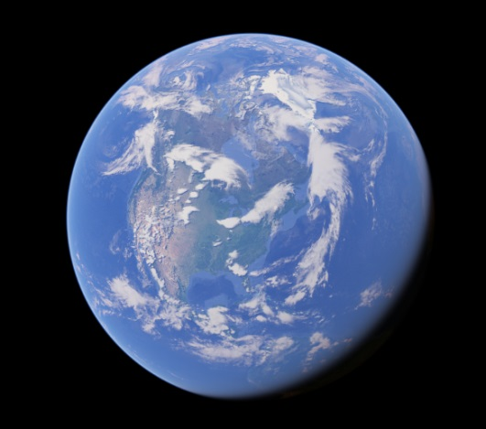
It can be a meaningless abstraction
It includes everything outside your skin
  And a word that means everything
  means nothing
Try using the word “everything” in place of “environment” and you’ll see the problem

Slide 4
In this class…
As much as possible we will refer to specific issues:
  Air quality
  Water quality
  Land management
  Resource management
  Climate
  Etc.
These are not the same issues; each one raises different considerations

Slide 5
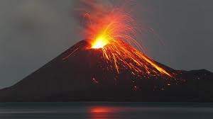
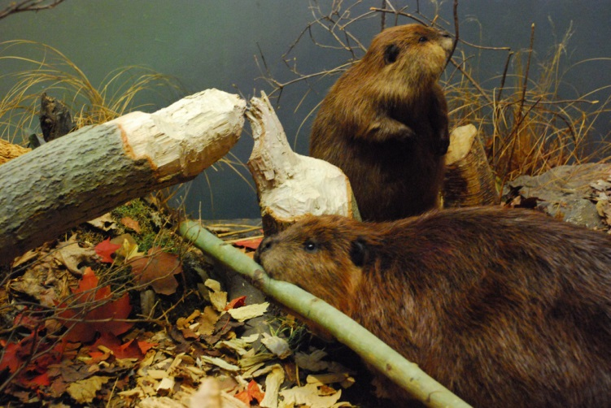
The nature of value
Are humans “harming” the natural world?
Nature cannot “harm” nature
One part just changes and
reorganizes another

Slide 6

The nature of value
What about humans?
If humans are part of nature, then everything humans do is natural.
So humans can’t “harm” nature either, just change it.

Slide 7
The nature of value
What about humans?
But suppose we take the view that humans are harming nature, not just changing it.
That means humans aren’t part of nature.

Slide 8
The nature of value
What about humans?
So you can’t argue that humans are just another part of nature and that human activity is harmful to the natural word.

Slide 9
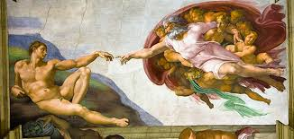

The nature of value
If humans are not part of nature, what are they?
The main options are:
  Something special
  An aberration

Slide 10
The nature of value
Something special:
  Humans are not part of nature, and their well-being is of primary concern
  The natural world matters insofar as it matters to people
  Humans can harm nature and can harm one another by changing nature in deleterious ways

Slide 11
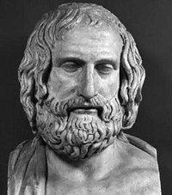
The nature of value
Something special:
  “Man is the measure of all things”
  Protagoras (~450 BCE)
  i.e. whether a thing has value, and what value it has, is a judgment by individual humans, it is not inherent in the thing itself or determined by a universal law

Slide 12
The nature of value
Aberration:
  Humans are not part of nature, and they matter less than nature
  The natural world has intrinsic value that is maximized when human activity is minimal or absent
  Humans harm nature by everything they do

Slide 13
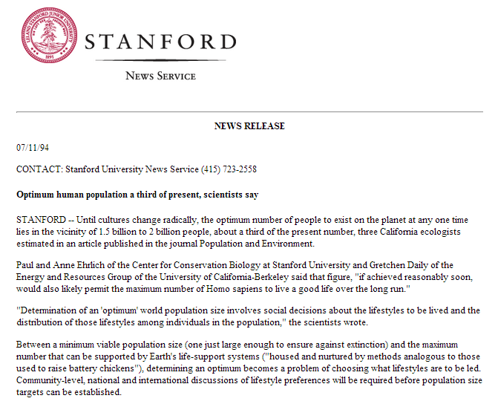
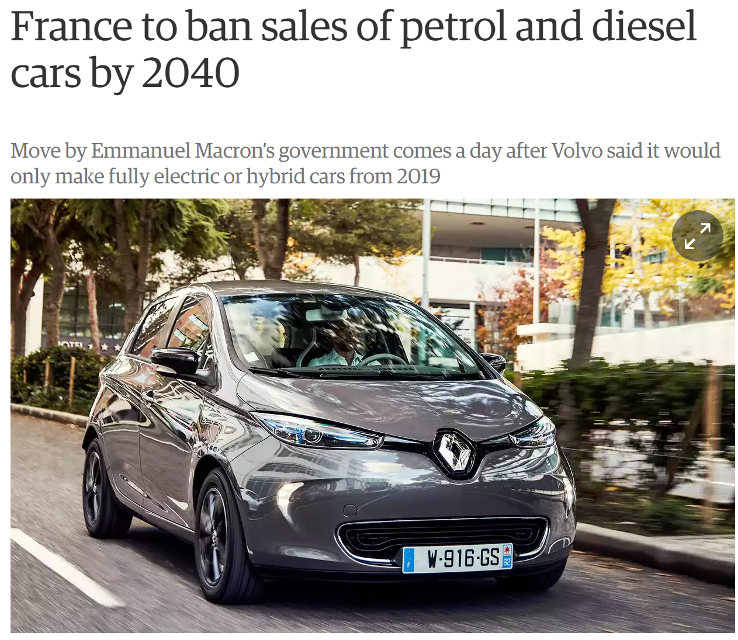
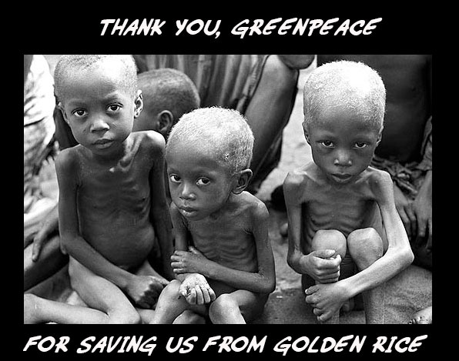
Is environmentalism anti-human?
The latter view can lead to radically inhumane opinions

Slide 14
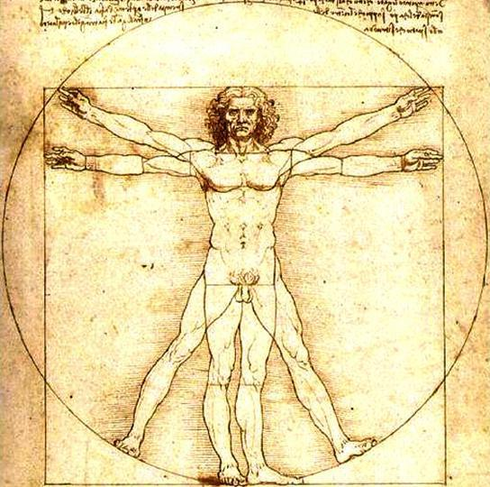
In this class
Human welfare is the criterion for valuing things
Air quality, water quality, forest space, etc., all matter because they are valuable to people

Slide 15
The Energy Connection
Economic growth and air pollution are linked through the harnessing of energy
Energy requires a mechanism to turn it into usable power
Economic history closely follows development of mechanisms

Slide 16
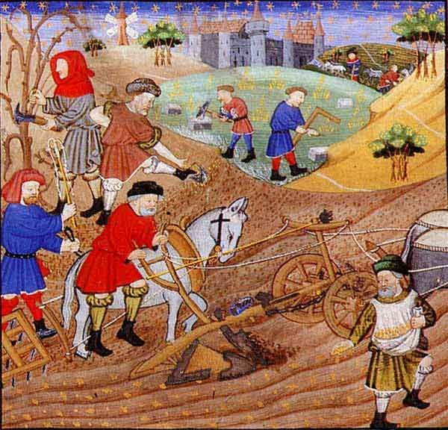
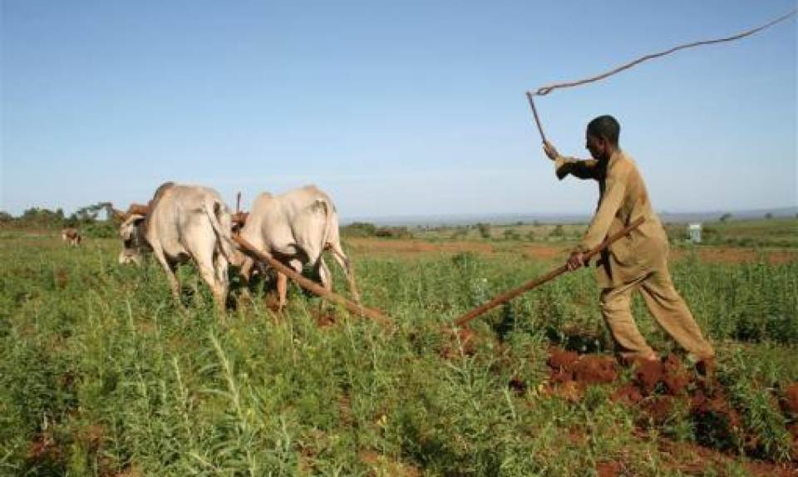
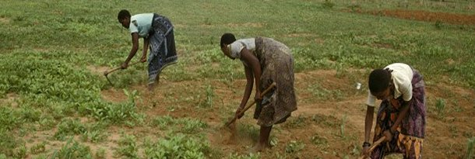
Power mechanisms
Human and animal

Slide 17
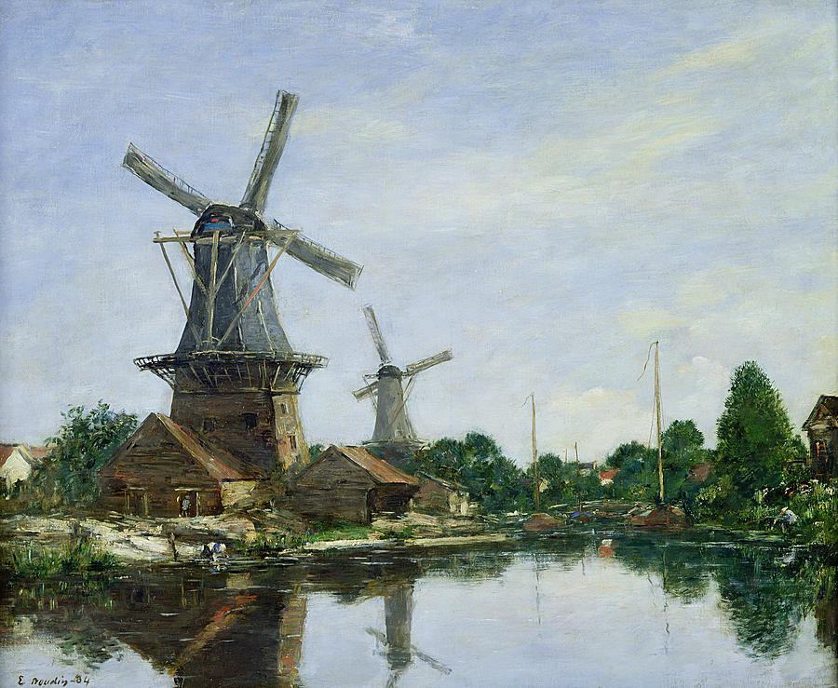
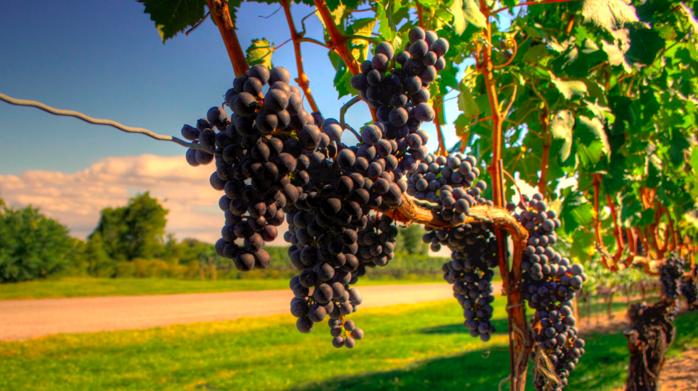
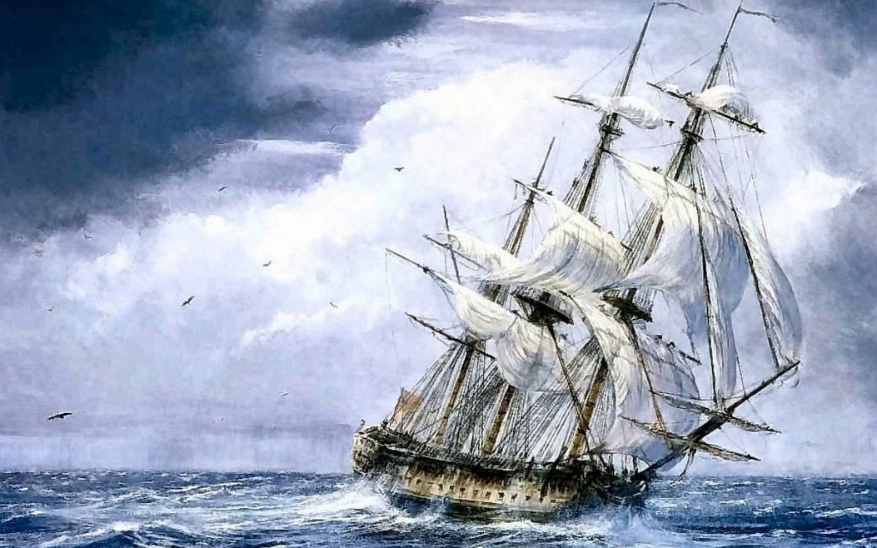
Power mechanisms
Wind, water and sun

Slide 18
Power mechanisms
Modern world arose from finding and learning to use fossil fuels (as well as hydro and nuclear energy)
Concentrated energy and efficient mechanisms
Power output rose by spectacular amounts

Slide 19
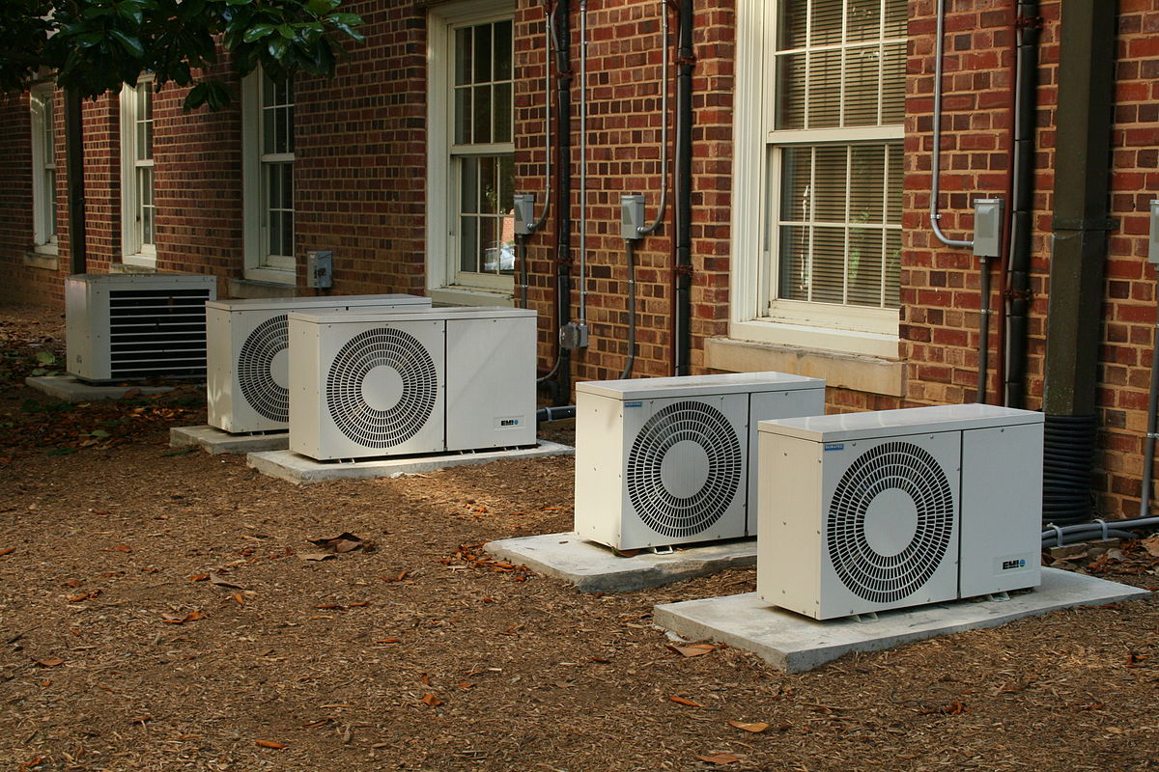
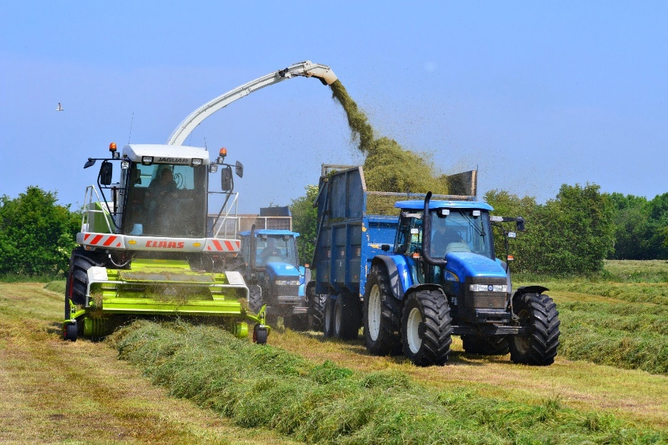
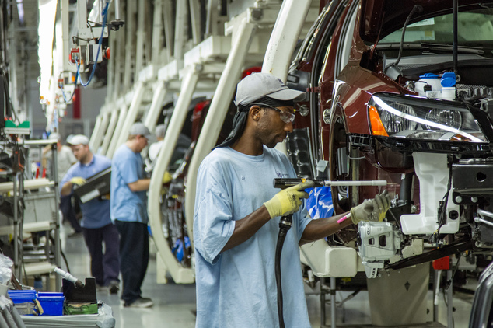

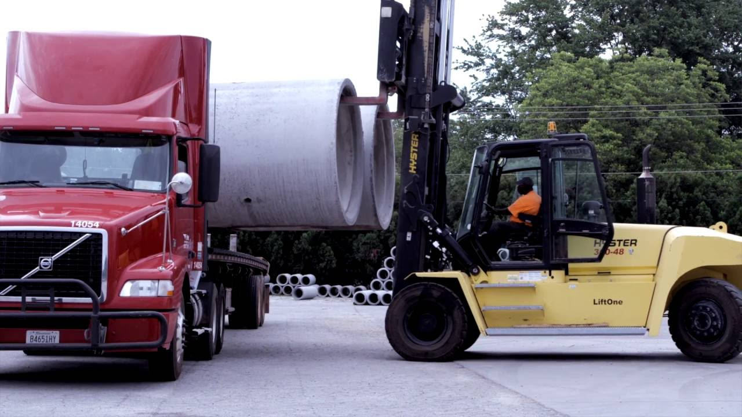
Power mechanisms

Slide 20
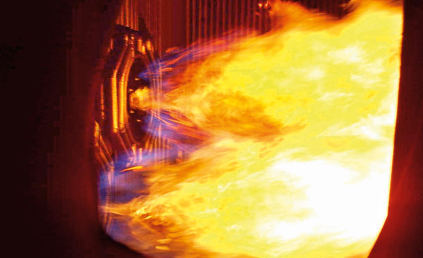
Combustion
Fuel-powered processes rely on combustion
Reaction of H+C+O₂ ➔ CO₂ + H₂O + heat

Slide 21
Combustion
Air pollution arises from by-products:
  Use of air (rather than oxygen)
  Impurities in the fuel
  Incomplete combustion
  CO₂

Slide 22
Air Pollution
Ground Level Ozone (O₃)
Nitrogen Oxides (NOx)
Particulate Matter (PM, TSP)
Sulphur Oxides (SOx)
Volatile Organic Compounds (VOCs)
Carbon Monoxide (CO)

Slide 23
Air Pollution
Some result from emissions:
  SOx, NOx, particulates, VOCs, CO
Some formed by secondary processes
  PM2.5, O₃
These imply very different control problems

Slide 24
Air Pollution vs Income
Is it like this?

Slide 25
Air Pollution vs Income
Notes:
Sources for this and next 2 slides:
Pollution data from World Bank Pollution Data: http://www.worldbank.org/wdi;
Pollution measures for 1995 except Johannesberg, Santiago, New York, Los Angeles: TSP measures for 1994, taken from survey in "Air Quality in Ontario 1995“ from Ontario Ministry of Environment; Background information is available in the 1998 World Development Indicators, p.162.
Income Per Capita as of 1995: from Penn World Tables, http://datacentre2.chass.utoronto.ca/cgi-bin/pwt/getrank?b=1989&s=RGDPT

Slide 26
Air Pollution vs Income
Notes:
Sources: See slide 12

Slide 27
Air Pollution vs Income
Notes:
Sources: see slide 12

Slide 28
Ozone: 11 AM, Bay&Wellesley

Slide 29
Ozone: Monthly Averages

Slide 30
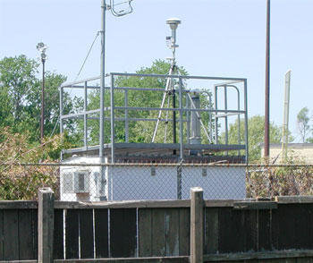
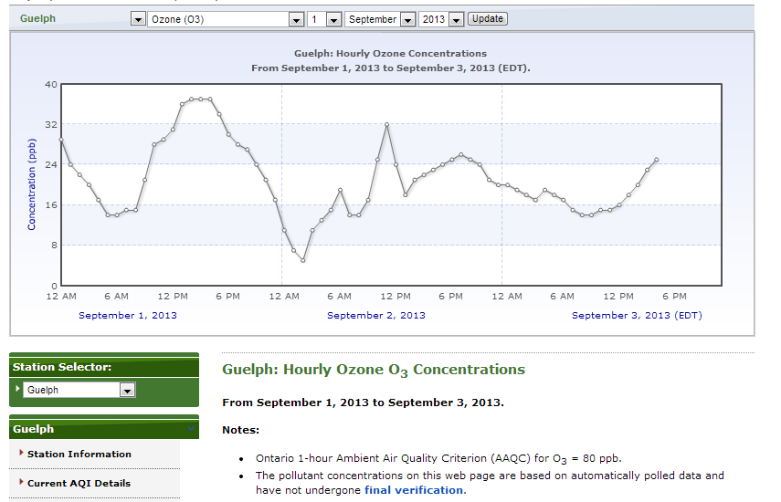
airqualityontario.com
Guelph

Slide 31
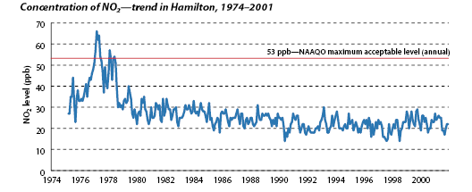
NO2: Monthly Averages

Slide 32
TSP: Monthly Averages

Slide 33
Toronto Air Pollution Trends

Slide 34
Toronto Air Pollution Trends

Slide 35
Toronto Air Pollution Trends

Slide 36
Toronto Air Pollution Trends

Slide 37
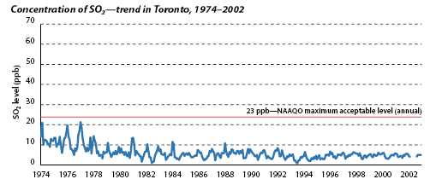
SO₂: Monthly Averages

Slide 38
Air Pollution Since 1940: USA
Notes:
Source: US EPA, http://www.epa.gov/oar/aqtrnd98/appenda.pdf

Slide 39
Air Pollution vs Income: USA
Notes:
Source for this and next slide
Pollution: http://www.epa.gov/oar/aqtrnd98/appenda.pdf
GDP per capita http://www.economagic.com/em-cgi/data.exe/beanat/t102101:q2a+a

Slide 40
Air Pollution vs Income: USA

Slide 41
Water Pollution (Kg/worker/day) vs Income
Notes:
Sources: World Bank, World Development Indicators (water pollution); Penn World Tables (GDP per capita)

Slide 42
Water Pollution: Great Lakes
Notes:
Source for this and next slide: Canada Centre for Inland Waters, Burlington

Slide 43
Water Pollution: Great Lakes

Slide 44
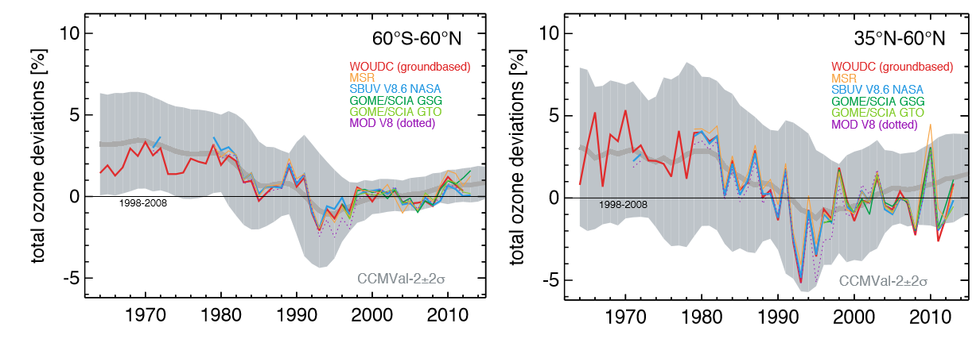
Global Issues: Ozone Layer
Notes:
https://www.esrl.noaa.gov/csd/assessments/ozone/2014/summary/ch2.html

Slide 45
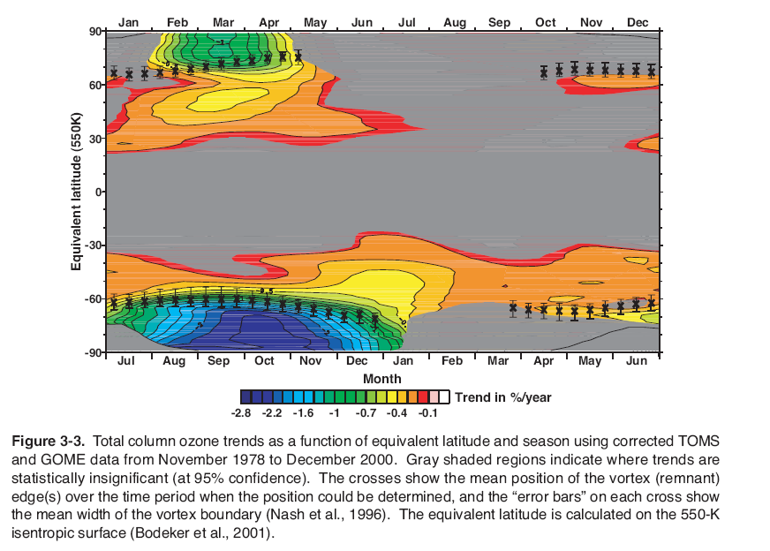
Global Issues: Ozone Layer

Slide 46
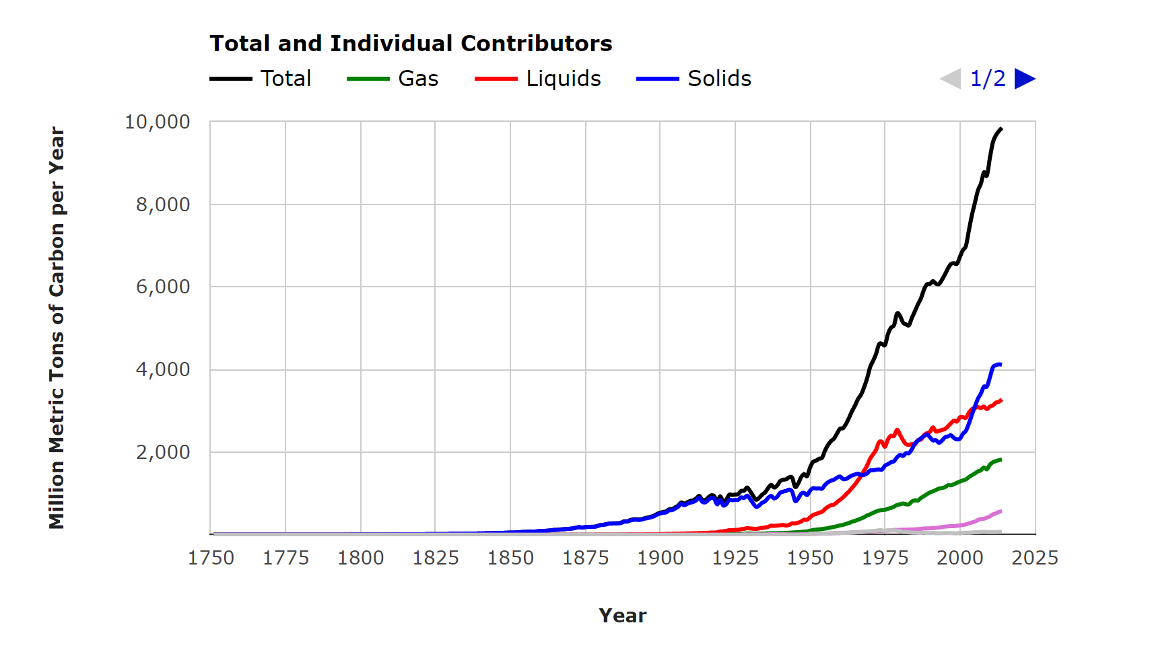
Global Issues: Global Warming
Total CO2 emissions (in C equivalent)
Notes:
http://cdiac.ornl.gov/trends/emis/glo_2014.html

Slide 47
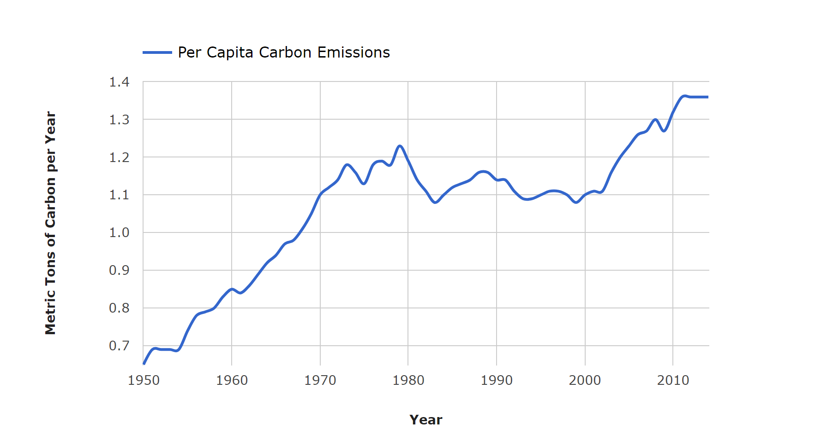
Global Issues: Global Warming
CO2 emissions per capita
Notes:
http://cdiac.ornl.gov/trends/emis/glo_2014.html

Slide 48
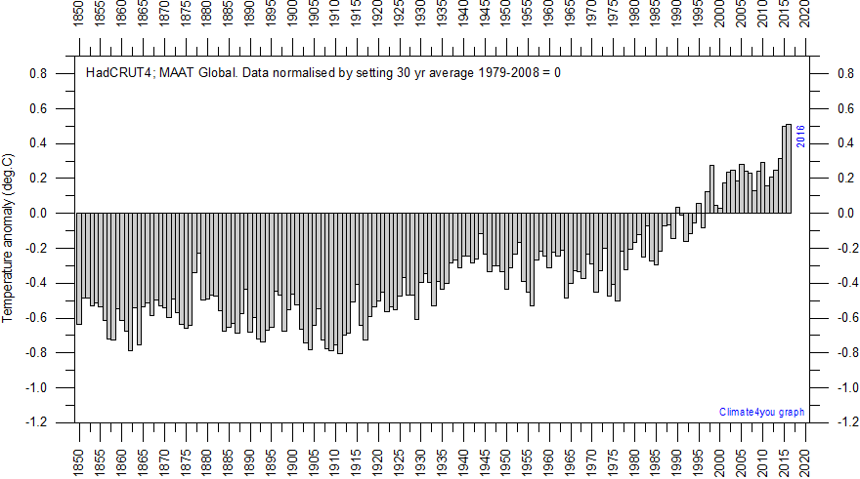
Global Issues: Global Warming
Notes:
http://www.climate4you.com/

Slide 49
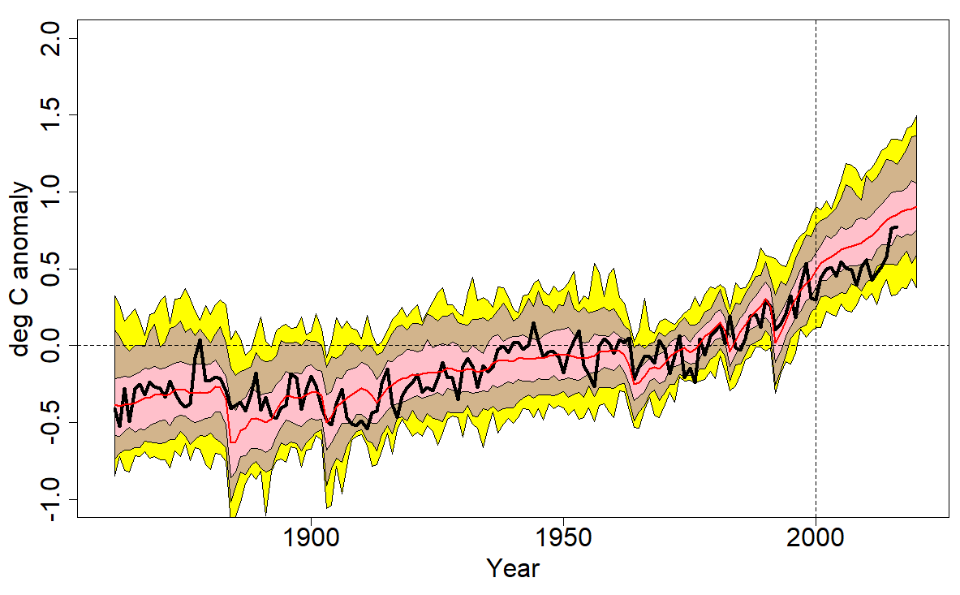
Global Issues: Global Warming
Models versus observations
Notes:
Black line http://www.metoffice.gov.uk/hadobs/hadcrut4/data/current/time_series/HadCRUT.4.5.0.0.monthly_ns_avg.txt
CMIP5 lines https://climexp.knmi.nl/start.cgi?id=someone@somewhere

Slide 50
Summary
The “Environment” as an abstract term: it makes more sense to discuss specifics
To think of human activity as damaging to nature requires putting humans in a separate category from the rest of nature
Valuing environmental damage requires adopting a human-centered point of view

Slide 51
Summary
Combustion of fossil fuels ties economic growth to air pollution
Most air pollutants do not necessarily increase with economic growth, many go down
Stratospheric ozone depletion mainly occurred in polar regions and in the mid-latitudes during late Winter and early Spring
CO₂ emissions grow with fossil fuel use. CO₂ is a greenhouse gas that is believed to have a warming effect on the climate

Slide 52
Next
Models of economic growth

