Slide 1
ECON*2100 Week 1 – Lecture 2
The Story of Economic Development

Slide 2
2 Worlds
Pre-1800
Post-1800

Slide 3
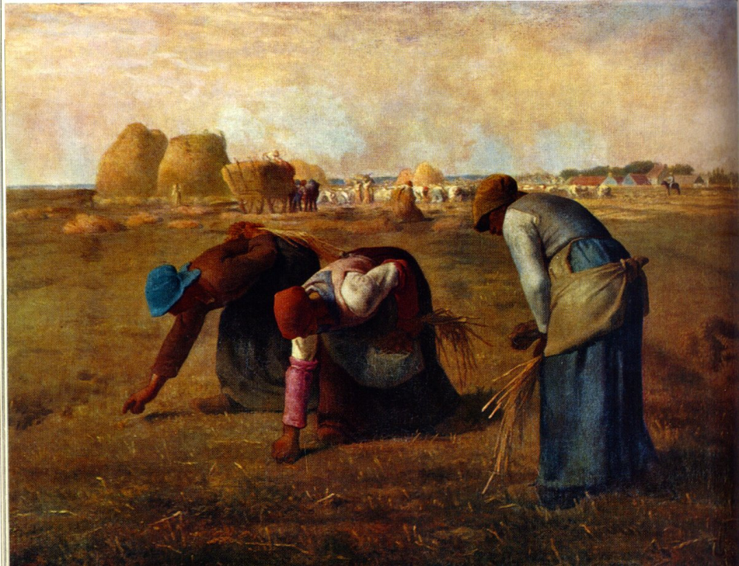
The Pre-1800 World
Agriculture-based
Subsistence economies
High level of equality
Low life expectancy

Slide 4
The Numbers
World population
AD 0: 231 million
1000: 267 million
1500: 425 million
1820: 1.1 billion
World GDP (1990$)
AD 0: 103 billion
1000: 117 billion
1500: 240 billion
1820: 695 billion

Slide 5
Growth began in 1800
Everything began to change in western countries
Proportion involved in agriculture began to decline
Economies moved off subsistence
Inequality increased
Fossil fuels began to be exploited
Life expectancy grew

Slide 6
Growth began in 1800

Slide 7
Growth begets growth
The Power of Compounding
Growth rate r (%) per year
Suppose r = 5% (or, 0.05)
Growth factor (1+r)
Then (1+r) = 1.05
Take principle P=$1,000 and let it grow for 1 year
This yields:
1000(1+r) = 1000x1.05 = 1050.

Slide 8
Growth begets growth
Now suppose we let $1050 grow for a year
1050(1+r) = 1050x1.05 = 1102.50
Notice the increment is now larger:
$50.00 earned in first year
$52.50 earned in second year
That’s because we earned interest on the interest

Slide 9
Growth begets growth
We could have solved for the second amount directly:
$$\left[1000\left(1+r\right)\right]×\left(1+r\right)=1000{\left(1+r\right)}^{2}$$
More generally, after T years we have
$$1000{\left(1+r\right)}^{T}$$

Slide 10
Growth begets growth
This is an exponential process
Time translates small growth rates into large changes
T

Slide 11
Growth begets growth
Suppose three countries start at $1,000 per capita
Each grows at different rates:
Slow : 1%
Medium: 2%
Fast: 3%
After 20 years:
Slow country: $1,220 per capita
Medium country: $1,486 per capita
Fast country: $1,806 per capita

Slide 12
Growth begets growth
Suppose three countries start at $1,000 per capita
Each grows at different rates:
Slow : 1%
Medium: 2%
Fast: 3%
After 100 years:
Slow country: $2,705 per capita
Medium country: $7,245 per capita
Fast country: $19,219 per capita

Slide 13
Structural changes
As countries develop, agricultural productivity increases
Workers leave the Ag sector and enter industry and services
Employment shares change over time:

Slide 14
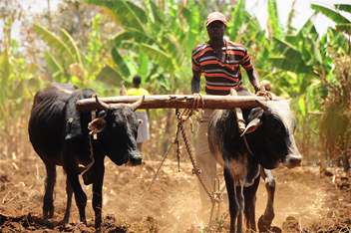
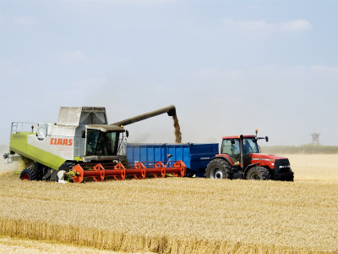
Structural changes
The amount of capital available for each worker goes up

Slide 15
Economic Growth: Summary
Pre-1800 there was little global growth
Post-1800 there has been a lot, though not evenly experienced
Human health, measured as expected lifespan, has increased dramatically
On balance the good aspects greatly outweighed the bad

Slide 16
Economic Growth: Summary
Due to compounding, small changes in annual rate yield large changes in outcomes over time
Growth involves changes in balance of sectors and techniques within sectors
Income growth requires increase in capital per worker, which in turn requires savings and investment
Question: Why do people in some countries save & invest and others do not?
This often comes down to local institutional differences

