Slide 1
ECON*2100
Week 1 – Lecture 1
5 Big Questions

Slide 2
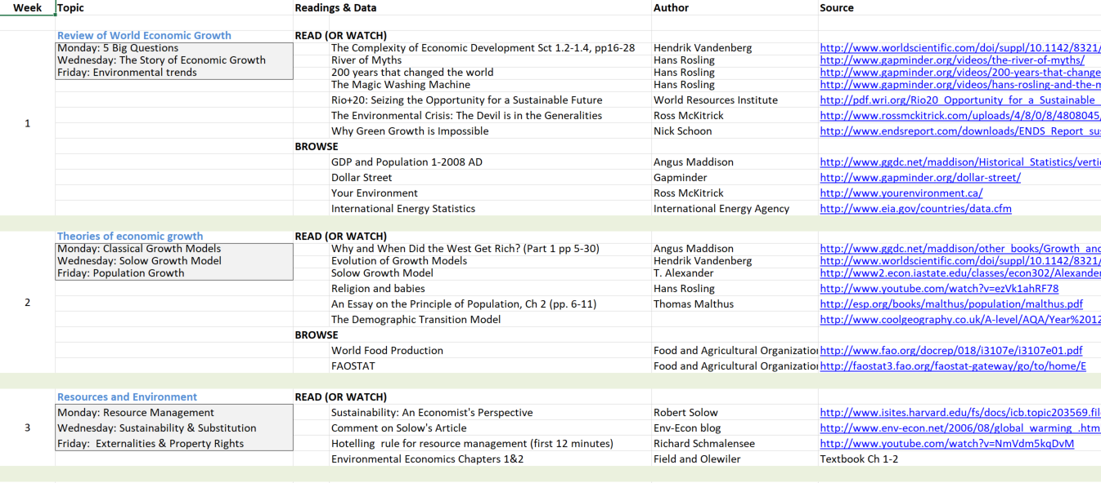
Readings file

Slide 3
4 Big Questions
Why do economies grow?
Is growth bad for the environment?
Are we running out of resources?
What policies should we use to make future generations better off?

Slide 4
1. Why do economies grow?
Because people want better lives

Slide 5
1. Why do economies grow?
Growth arises from natural social processes:
  specialization, savings, free exchange, innovation

Slide 6
1. Why do economies grow?
Output growth vs Income growth:
  Suppose total output = 100 units, and there are 50 workers. Then income = 2 units per worker
  If output goes up to 200 units and there are still 50 workers, income grows to 4 units per worker
  If output goes up to 200 units but there are now 100 workers, income stays at 2 units per worker
Output grew each time but income did not
“Extensive growth” – output
“Intensive growth” – income

Slide 7
2. Is growth bad for the environment?

Slide 8
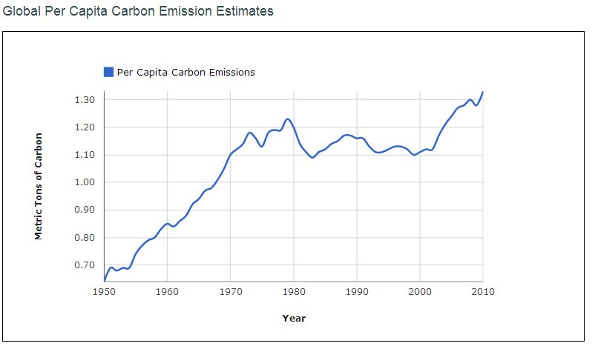
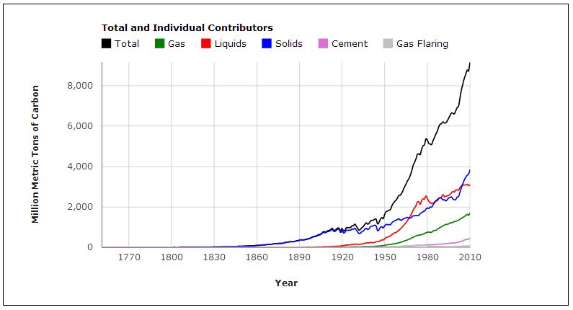
2. Is growth bad for the environment?
So unless CO2 is a BIG problem, the answer is probably no.
No. Wealthy countries are cleaner than poor countries
The only exception concerns CO2 emissions

Slide 9
3. Are we running out of resources?
No, we do not “run out”
All that happens is some become too costly to use, and we have to find substitutes.

Slide 10

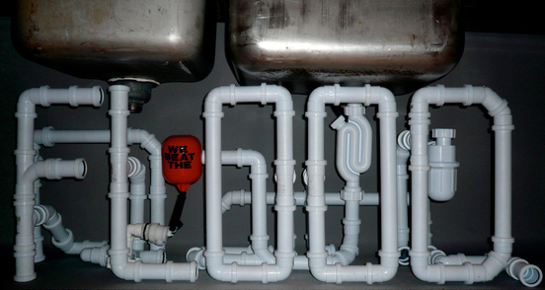
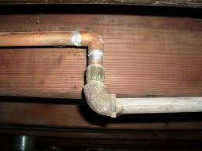
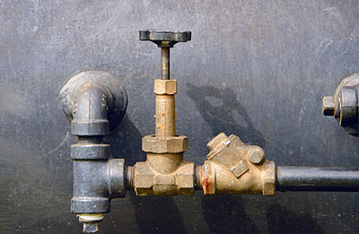
3. Are we running out of resources?

Slide 11
45. What policies should we use to make future generations better off?
Pricing externalities (and other forms of pollution control policies)
Promote efficient use of natural resources
Promote economic growth

Slide 12
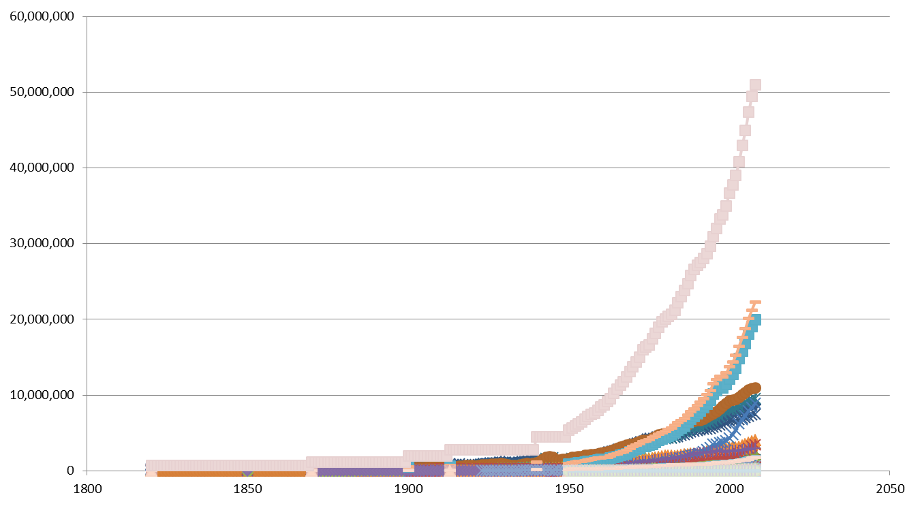
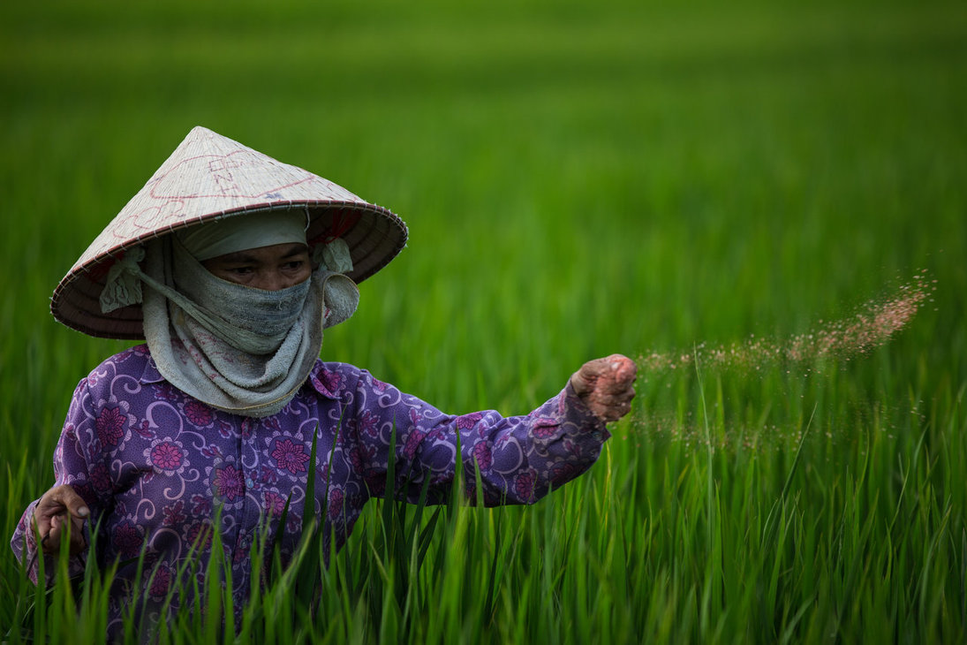
Next: The Story of Development

