Slide 1
Issues in Carbon Pricing
Harvard Electricity Policy Group
Scottsdale AZ
December 2016
Presented by:
Ross McKitrick
University of Guelph

Slide 2
Summary
“Second-best” analysis shows carbon tax unlikely to improve welfare
Empirical evidence on model parameters & realistic implementation issues undermine case even more
We should re-think carbon pricing along the lines of monetary policy

Slide 3
First-Best Model
$/unit
MAC = (Private) Marginal Abatement Costs
$$\overline{E}$$
Emissions

Slide 4
First-Best Model
$/unit
MAC
MD = Marginal Damages
$$τ^{∗}$$
$$E^{∗}$$
$$\overline{E}$$
Emissions

Slide 5
Second-Best Case
$/unit
MAC_{S} = Social Marginal Abatement Costs
MAC_{P}
MD
$$τ^{∗}$$
$$E^{∗}$$
$$\overline{E}$$
Emissions

Slide 6
Second-Best Case
$/unit
MAC_{S}
MAC_{P}
MD
$$τ^{∗}$$
$$E^{∗}$$
$$\overline{E}$$
Emissions

Slide 7
Second-Best Case
$/unit
MAC_{S}
MAC_{P}
MD
$$τ^{∗}$$
$$E^{∗}$$
$$\overline{E}$$
Emissions

Slide 8
Second-Best Case
Taking into account other distortions in tax system
$$τ^{∗}=\frac{MD}{MCPF}$$
where MCPF = Marginal Cost of Public Funds
~ 1.4 or so

Slide 9
Tax Revenues
This is the outcome with optimized taxes and full revenue recycling
What if neither assumption holds?
Command-and-Control or Tradable Quotas
Non-optimal tax system

Slide 10
Second-Best Case
$/unit
MAC_{S}
MAC_{P}
MD
$$τ^{∗}$$
$$E^{∗}$$
$$\overline{E}$$
Emissions

Slide 11
Third-Best Case
$/unit
MAC_{S}
MAC_{P}
MD
$$τ^{∗}$$
$$E^{∗}$$
$$\overline{E}$$
Emissions

Slide 12
Third-Best Case
$/unit
MAC_{S}
MAC_{P}
MD
$$τ^{∗}$$
$$E^{∗}$$
$$\overline{E}$$
Emissions

Slide 13
Third-Best Case
$/unit
MAC_{S}
MAC_{P}
MD
$$τ^{∗}$$
B
$$E^{∗}$$
$$\overline{E}$$
Emissions

Slide 14
Threshold Value
B = cost of first unit of emission reductions if
tax system is sub-optimal +/or
Carbon tax is not sole instrument +/or
Policy is not revenue-raising/revenue neutral
Bovenberg and Goulder (1996): B = $50/tonne
IWG (2013) MD = $40/tonne
B > MD: Carbon tax is welfare-reducing even if there is a positive externality

Slide 15
Looking closer at SCC
SCC estimates come from IAM black boxes
DICE (Nordhaus), FUND (Tol), PAGE (Hope)
Yield MD or Social Cost of Carbon (SCC)
Depend heavily on Equilibrium Climate Sensitivity (ECS) parameter

Slide 16
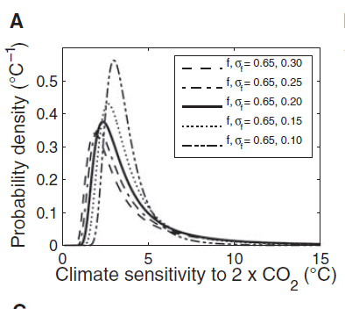
ECS
Small uncertainty in feedback rate yields big spread and fat upper tail

Slide 17
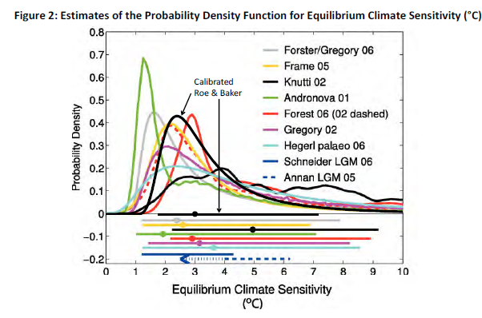
Inter-Agency Working Group (IWG)
Used Roe-Baker (2007) ECS distribution, ran Monte Carlo analyses to generate SCC distribution
Generated mean SCC as of 2015 of $38 (@3.0%)

Slide 18
Problem #1: Time scale of upper tail inconsistent with damage path
Roe and Bauman (2013): Adjustment time goes up with square of ECS
IAMs do not take this into account and use physically-impossible time scales for high sensitivity cases

Slide 19
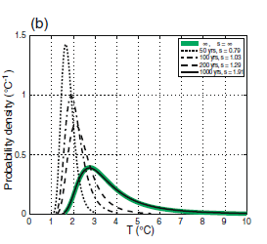
Problem #2: Empirical ECS estimates inconsistent with IWG distribution

Slide 20
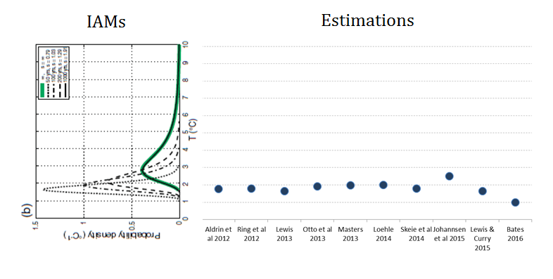
Problem #2: Empirical ECS estimates inconsistent with IWG distribution

Slide 21
Problem #2: Empirical ECS estimates inconsistent with IWG distribution

Slide 22
Problem #2: Empirical ECS estimates inconsistent with IWG distribution
DICE

Slide 23
Lewis & Curry 2015
Used IPCC forcings post-1750 and updated surface and ocean data
Conditioned ECS on estimated OHU efficiency
Results stable across numerous different start- and end-dates
ECS best estimate 1.64 C
[5—95%] range of 1.05 – 4.05 C

Slide 24
FUND & DICE
We used EPA’s Matlab code
Replicated IWG results

Slide 25
Avg of DICE and FUND
Avg SCC Estimate out to 2050

Slide 26
My (ideal) alternative
Temperature-indexed carbon tax
Simple linear function of satellite-derived atmospheric temperature measure
If warming happens, tax will go up, and vice versa
Futures market for tax exemption certificates
Sequence of prices would reveal market expectation of warming

Slide 27
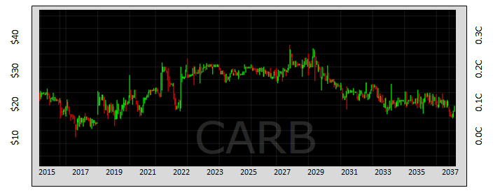
Futures market
The market will become the world’s most powerful climate model
We can show these forecasts are unbiased and use all available information

Slide 28
Conclusions
Real-World considerations make it unlikely carbon regulations can pass Cost-Benefit test
Even a carbon tax is unlikely to be a net benefit
SCC estimates are likely biased high due to skewed ECS distribution
In FUND model CO2 is not necessarily even a net negative externality
I propose re-thinking carbon pricing using monetary policy as an analogue

