Slide 1
The Environmental Crisis: The Devil is in the Lack of Details
Presentation to the Canadian Sustainable Use Network
Calgary AB
June 24, 2014
Ross McKitrick
Department of Economics, University of Guelph

Slide 2
A word we should unlearn
Environment

Slide 3
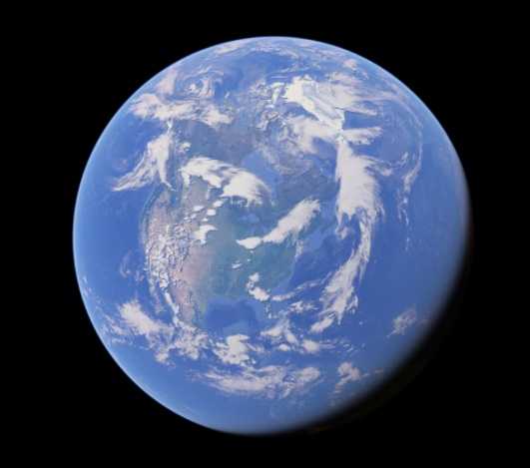
The “Environment”
The word literally means everything
Therefore it means nothing
“The Environment” is not one issue, it is hundreds of different issues

Slide 4
The “Environment”
By bundling everything into one word we create 2 problems:
Detachment from empirical evidence
Perception that everything is in a state of crisis

Slide 5
The remedy is…
Only ever be specific
Are you referring to…
Air quality
Water quality
Land management
Resource management
Climate
Etc.
These are all different issues with different details
Nor are they all “problems”

Slide 6
And these categories are still too broad
E.g. air quality:
Gases versus particles versus aerosols
Emitted compounds versus precursors
Local versus long range
Threshold effects
Abatement options

Slide 7
Attempts to Measure the “Environment”
1980s/90s: search for a grand “indicator”
NRTEE Indicators project
Collected dozens of candidate measures
Couldn’t figure out how to add them up
Wasn’t willing to assign $ values

Slide 8
Attempts to Measure the “Environment”
Similar efforts: Genuine Progress Indicator, “Green” GDP, etc.
Problems: weights are arbitrary, results are too abstract

Slide 9
Proposed alternative
Let’s start thinking and talking about the “environment” as lots of individual issues, mostly local, all with individual characteristics, complexities and measurements.

Slide 10
Example 1
What are the environmental impacts of hog production?
What are the effects of a 1,000-head hog operation on nearby lake and river phosphorous levels, regional NOx levels, local forest cover, mid-tropospheric temperature trends and stratospheric ozone?

Slide 11
Example 1
What are the environmental impacts of hog production?
What have been the effects of large hog operations in Waterloo County on Grand River phosphorous, nitrates, dissolved oxygen, and E. Coli levels?

Slide 12
Example 2
What should we do about air pollution in Canada?
What are the current levels of sulphur dioxide, nitric oxide, nitrogen dioxide, carbon monoxide, PM2.5, PM 10 and ozone in every location across Canada, are any of these at problematic levels, and if so, what would be the best response?

Slide 13
Example 2
What should we do about air pollution in Canada?
What are the current levels of sulphur dioxide, nitric oxide, nitrogen dioxide, carbon monoxide, PM2.5, PM 10 and ozone in BC communities, are any of these at problematic levels, and if so, what would be the best response for that community?

Slide 14
Example 3
How long before we lose the Athabasca Glacier due to climate change?
How have air temperatures changed in the vicinity of the Athabasca Glacier over the 20th century, and can these changes be attributed to any one cause?

Slide 15
Example 3
How long before we lose the Athabasca Glacier due to climate change?
How have air temperatures changed in the vicinity of the Athabasca Glacier over the 20th century, and can these changes be attributed to any one cause?

Slide 16
Example 4
Should we crack down harder on industry for its air pollution emissions?
How have air temperatures changed in the vicinity of the Athabasca Glacier over the 20th century, and can these changes be attributed to any one cause?

Slide 17
Example 4
Should we crack down harder on industry for its air pollution emissions?
What are the sources of particulate emissions in Canada, and what might be some low cost options if we want to reduce them?

Slide 18
Commonalities
Specific questions with specific answers
No need for pointless ideological or abstract debates
We can agree on the objective matters and then have a focused debate on the subjective matters.
People might be surprised at what the numbers show

Slide 19
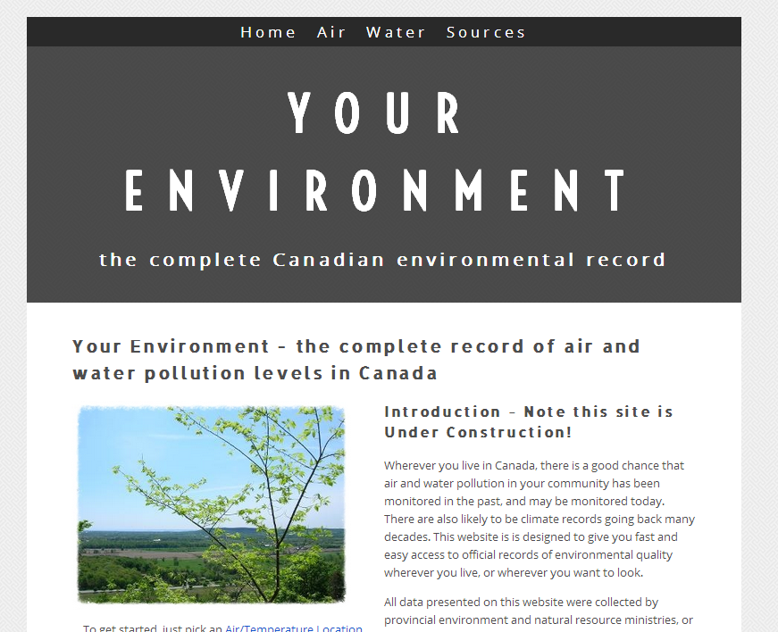
How this can work in practice
yourenvironment.ca
I’m building a
complete online
archive of
Canadian air and
water quality
records

Slide 20
Yourenvironment.ca

Slide 21
For example: Motor Vehicle Emissions
What if the discussion started with facts rather than fear and vague impressions?

Slide 22
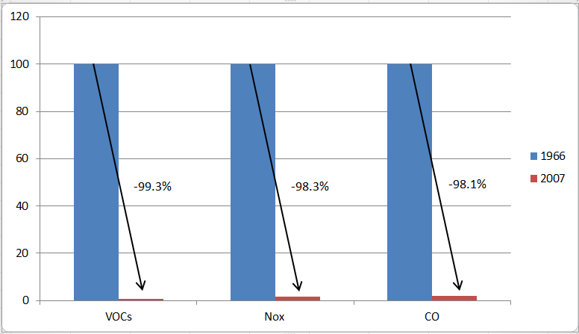
For example: Motor Vehicle Emissions
Allowable grams per mile

Slide 23
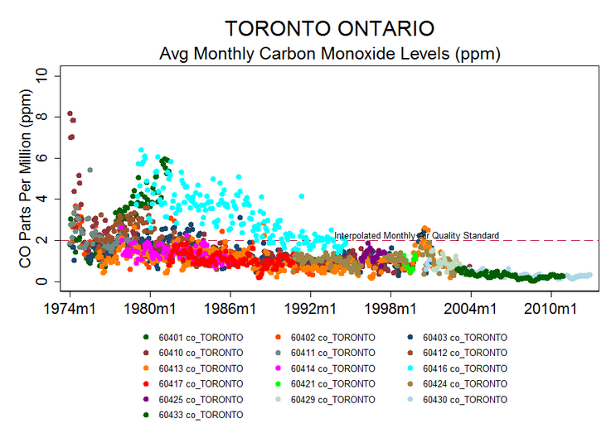
For example: Motor Vehicle Emissions
Result:

Slide 24
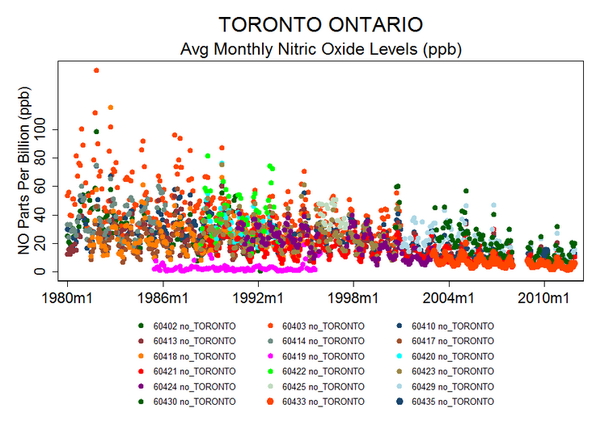
For example: Motor Vehicle Emissions
Result:

Slide 25
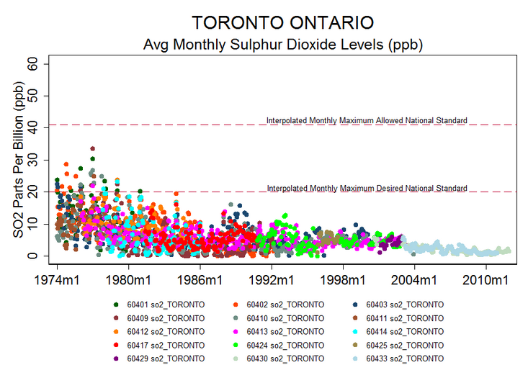
For example: Motor Vehicle Emissions
Result:

Slide 26
For example: Motor Vehicle Emissions
Yet the US and Canadian governments have announced even tighter emission standards through the next decade
These will have, at most, very small effects on urban air quality
They will make cars more expensive and less safe to drive
Wealthy households can insulate themselves from these effects because they can still afford large vehicles
The big losers are low-income households

Slide 27
My wish list
Obtaining more data for yourenvironment.ca:
Provincial river quality
Provincial lake quality
Great Lakes quality
Mercury deposition
Forest cover
Land use
Precipitation
Regulations

Slide 28
My wish list
Website system:
Spatial map-based approach
Multiple navigation options
Automated updating of graphs and source data
Content
School lesson plans by grade
Technical backgrounders

Slide 29
The Possible Outcome:
Move discussions away from the abstract notion of “The Environment” to local, concrete and observable parameters
Show people that these discussions can be based on measurable and understandable facts
Allow them to discover that not everything is a crisis, some problems have, actually, been solved, and it is possible to agree on reasonable priorities

Slide 30
The end.

