Slide 1
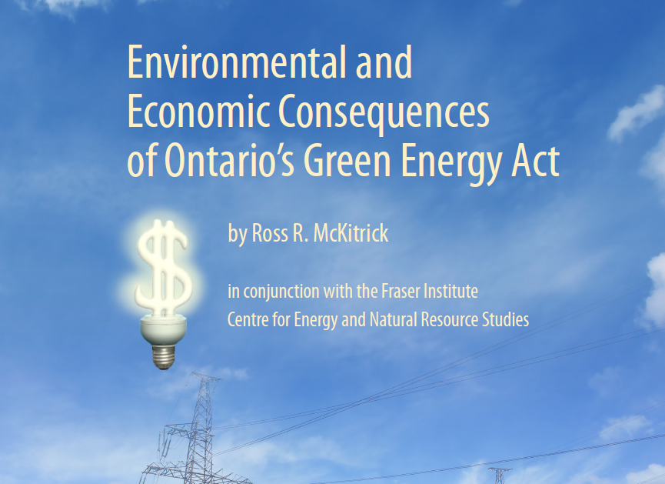
Professor of Economics,
University of Guelph
Senior Fellow, Fraser Institute

Slide 2

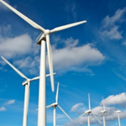
Green Energy Act 2009
Stated goals:
  Reduce conventional air pollution and greenhouse gases by replacing coal-fired power plants with renewable sources (wind, solar, biofuels and small hydro)
  Promote economic growth and job creation

Slide 3
3 questions
(1) Will the GEA materially improve environmental quality in Ontario?
(2) Is it a cost-effective plan for accomplishing its goals? and
(3) Are the economic effects on households and leading economic sectors likely to be positive?

Slide 4
Findings
  (1) No, the GEA is unlikely to yield any environmental improvements beyond those that would have happened anyway.
  Indeed it may result in increased air emissions.
  Equivalent benefits could have been obtained through a simple retrofit of the existing power plants at a fraction of the cost

Slide 5
Findings
(2) No, the GEA is already 10 times costlier than the alternative option and has only yielded a fraction of the power needed to replace coal.
Most Ontario wind power is generated when it is not needed and must be dumped on the export market at a significant loss.
Because wind turbines operate at less than 20% of their rated capacity about 50% of the time it takes 7 MW of new wind energy to replace 1 MW of coal-fired generating capacity.
If the province fulfills its generating targets the GEA will have been 70 x costlier than the alternative option.

Slide 6
Findings
(3) No, the GEA has contributed to Ontario having some of the highest electricity prices in North America, and a further 50% increase is forecast. This will harm the province’s economy, costing jobs and investment.
The Province’s claim that the GEA will create 50,000 jobs was baseless, and they have since admitted there was no evidence for it.
In reality the GEA will drive down the rate of return in key sectors like mining and manufacturing, leading to permanent job losses.

Slide 7
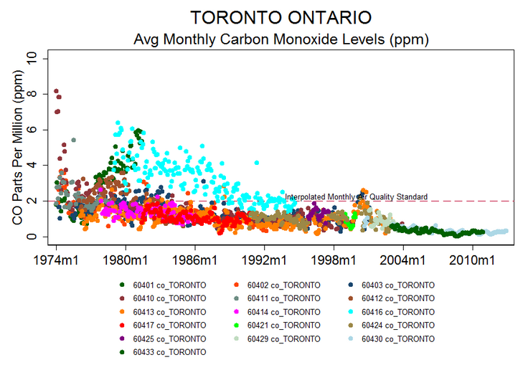
Air quality trends in Ontario
See yourenvironment.ca

Slide 8
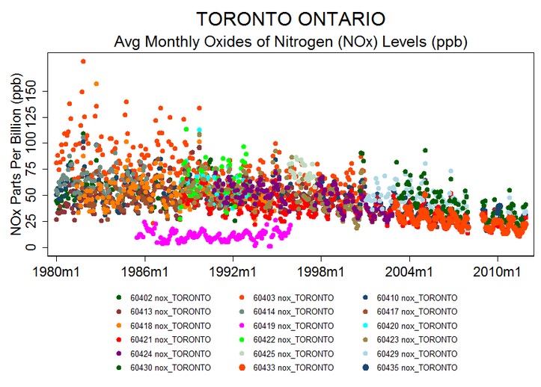
Air quality trends in Ontario
See yourenvironment.ca

Slide 9
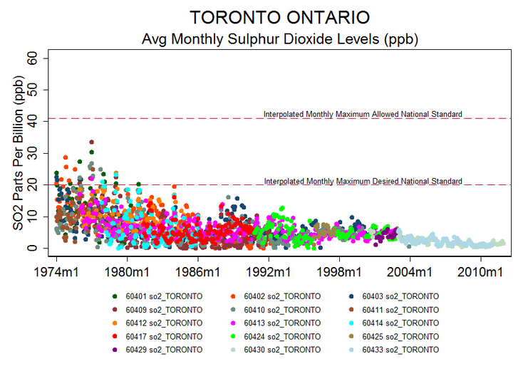
Air quality trends in Ontario
See yourenvironment.ca

Slide 10
Air quality trends in Ontario
See yourenvironment.ca

Slide 11
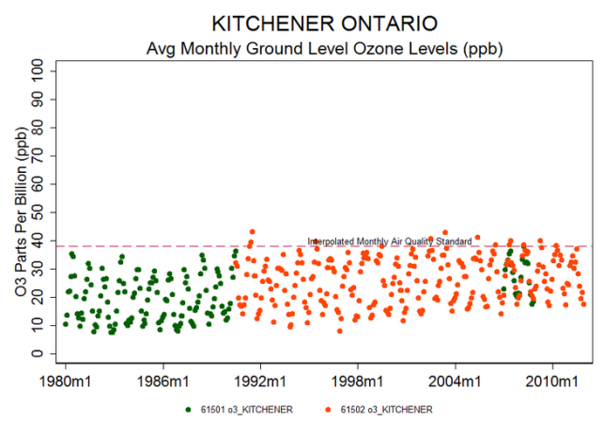
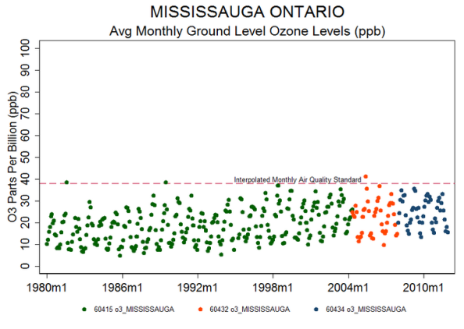
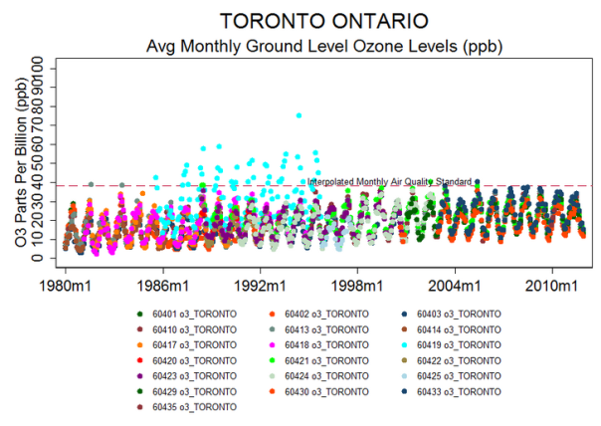
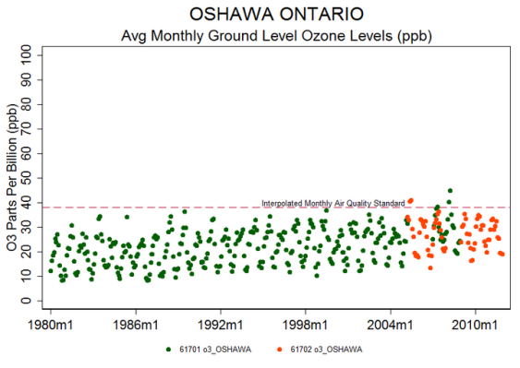
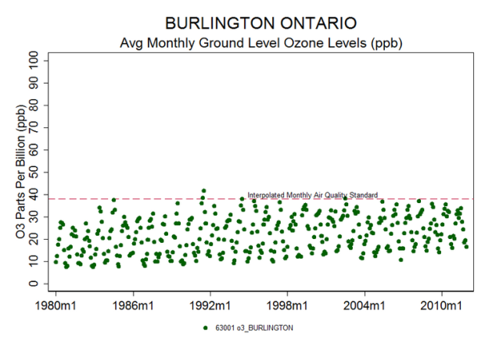
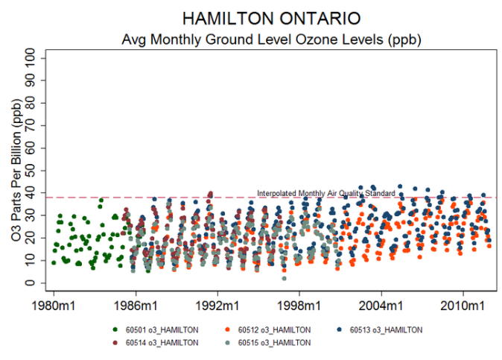
Air quality trends in Ontario
See yourenvironment.ca

Slide 12
Air quality trends in Ontario
Ontario Ministry of Environment (2010)
  “Overall, air quality has improved significantly over the years, especially for nitrogen dioxide (NO2), carbon monoxide (CO) and sulphur dioxide (SO2) - pollutants emitted by vehicles and industry.”
  The provincial Ambient Air Quality Criteria (AAQC) for NO2 and CO were not exceeded at any of the ambient air monitoring locations in Ontario during 2010.
  Nor were 24 hour SO2 standards for SO2 exceeded anywhere, nor were fine particulate (PM2.5) standards exceeded.

Slide 13
Focus on Closing Lambton & Nanticoke
Ontario Ministry of Energy Plan 2010 p. 2 :
  “Worst of all, Ontario relied heavily on five air-polluting coal plants. This wasn’t just polluting our air, it was polluting our lungs. Doctors, nurses and researchers stated categorically that coal generation was having an impact on health increasing the incidence of various respiratory illnesses. A 2005 study prepared for the government found that the average annual health-related damages due to coal could top $3 billion. For the sake of our well-being, and our children’s well-being, we had to put a stop to coal.”

Slide 14
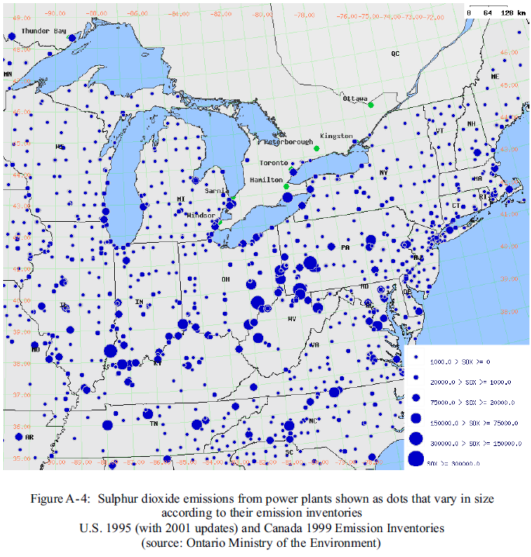
Power generation facilities in northeast
From AQO 2005 appendix
http://www.ene.gov.on.ca/envision/techdocs
/5158e_index.htm

Slide 15
Power generation facilities in northeast
From AQO 2005 appendix
http://www.ene.gov.on.ca/envision/techdocs
/5158e_index.htm

Slide 16
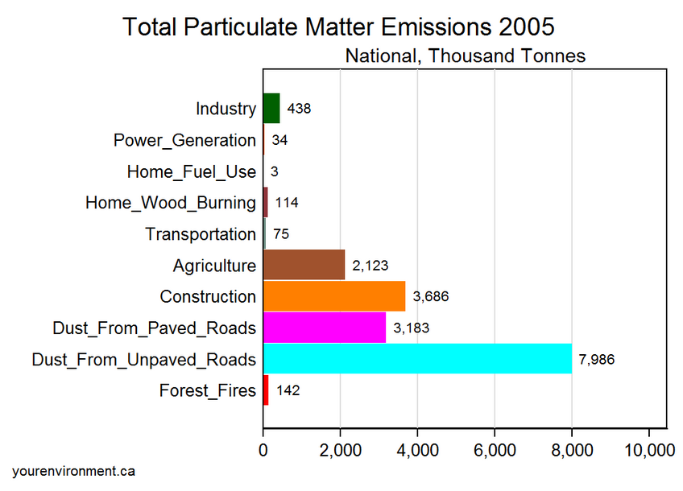
Sources of Particulate Emissions
Environment Canada:

Slide 17
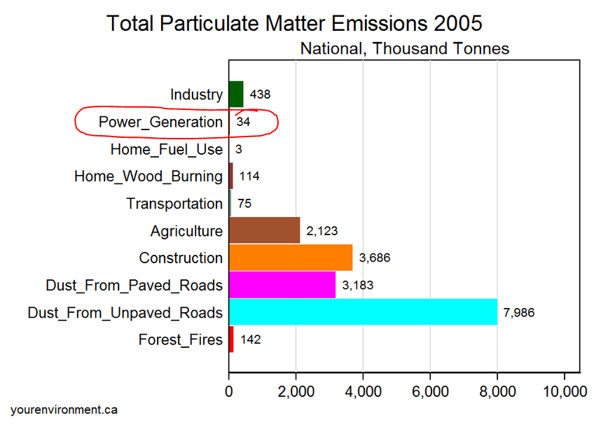
Sources of Particulate Emissions
Environment Canada:

Slide 18
2005 Study
Confidential report to Provincial Minister of Energy prepared by DSS Consulting and RWDI Engineering
Examined 4 scenarios for electricity:
  Business-as-usual
  2 combinations of nuclear and gas to replace coal
  Retrofit coal plants
Did not consider or recommend wind/solar/renewables

Slide 19
Strategies to reduce PM and Ozone
Close Lambton & Nanticoke:
  Toronto Ozone reduced by 0.02 parts per billion (0.08%)
  Toronto PM10 reduced by 1.1 µg/m3 (2%)
  Comparable changes in 55 of 57 locations across province
Keep them open but do a retrofit:
  Toronto Ozone reduced by 0.02 parts per billion (0.08%)
  Toronto PM10 reduced by 0.8 µg/m3 (2%)
Essentially identical under both scenarios
2005 Report neither considered nor recommended wind energy

Slide 20
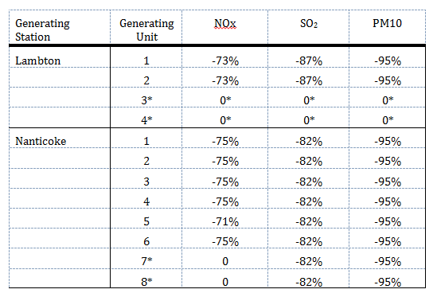
Cost-inefficiency of GEA
Retrofit option ($817 million)
  Fully offset GHG emissions
  Heavily reduce pollutant emissions

Slide 21
Cost-inefficiency of GEA
2010 Auditor-General Report
  No provincial analysis of costs of GEA
  Increased electricity bills costing Ontario households $2.2 billion/year
  “Global Adjustment” to power rates due to renewable energy contracts costing $2.7 billion/year
  New transmission facilities needed will cost about $1.5 billion
Just these items: $5 billion/year
And this only yields a small amount of electricity

Slide 22
Wind is intermittent

Slide 23
Wind is intermittent

Slide 24
Wind decreases at high demand times

Slide 25
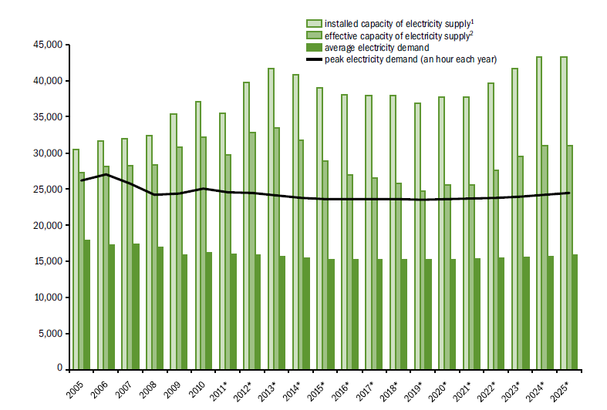
Wind vs nuclear
Wind power is unpredictable
New wind capacity requires almost 50% backup in the form of new gas-fired facilities
Ontario has surplus baseload power:

Slide 26
Wind vs nuclear
Additions of wind will require removing baseload sources, not variable sources
Implication: nuclear units will soon have to be taken offline and replaced with a wind/gas combination

Slide 27
The numbers
Replacing Lambton & Nanticoke: 7500 MW capacity
Eventually wind is supposed to provide 4800 MW capacity (64%)
  But wind only operates at 30% capacity on average
  41% in November when demand is at a minimum
  14% in July when demand is peaking
  To get 1 MW of year-round power requires 7 MW of new wind capacity
Current wind-related programs in GEA provides only 10% of planned wind capacity

Slide 28
The numbers
Current cost of GEA:
  On a scaled comparison to the retrofit option, the GEA currently costs 10x as much
  If the Province pursues full implementation the costs will increase to 73x the cost of the retrofit option

Slide 29
Making matters worse
The GEA mandates that the grid operator must buy* all available wind power at 13.5 ¢/kWh
80% of wind power generated in Ontario is surplus and must be exported, typically at less than 4 ¢/kWh
Ontario loses $24,000 for every hour wind turbines operate
Now costs $200 million per year to send power to the US
*The system operator can now bypass some wind energy, but the turbine operators are entitled to compensation payments for not generating power, which are funded by taxpayers.

Slide 30
Economic effects
Ontario used to have some of the cheapest electricity rates in North America
We are now near the top
US electricity prices are declining due to adoption of shale gas and maintenance of their coal-fired power plants
By 2015 Ontario will experience increases in rates of about 40-60% (AGO, Aegent advisors)

Slide 31
Analysis
Energy per unit of output

Slide 32
Analysis
Econometric model of unit cost elasticities for Forestry, Mining and Manufacturing

Slide 33
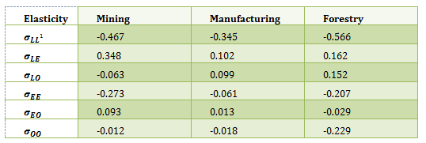
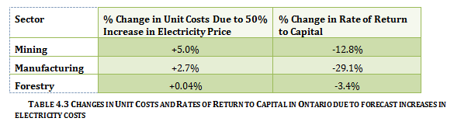
Analysis
Elasticities:
Unit Cost Effects:

Slide 34
Analysis
Results
Forecast increase in electricity costs will drive down the rates of return to capital by 29% (Mfg), 13% (Mining) and 0.3% (Forestry)
This will result in a loss of employment and shrinking industrial activity, not growth

Slide 35
Summary
(Note I have not discussed lost property values and health costs of wind turbine farms)
  Ontario did not have an air pollution problem in 2009 that required intervention in the form of the GEA. And even if it did, the GEA will not materially improve air quality in Ontario
Wind energy was never recommended in the Province’s 2005 study. If wind production targets are met it will cost 70x that of an alternative strategy already underway in 2005 that would yield equivalent environmental benefits
The GEA will not create jobs or promote growth. It is driving down the rate of return to capital in mining and manufacturing and will lead to reduced investment and employment in the province

Slide 36
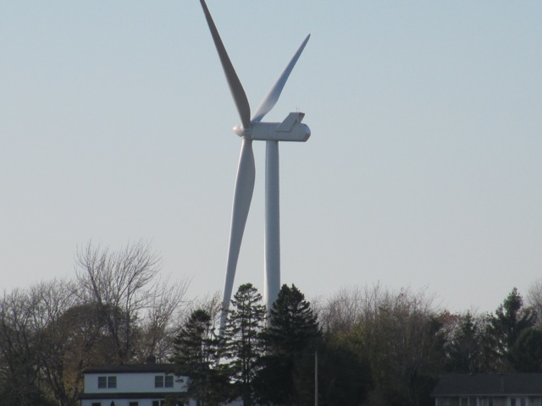
Summary

